Slide 1
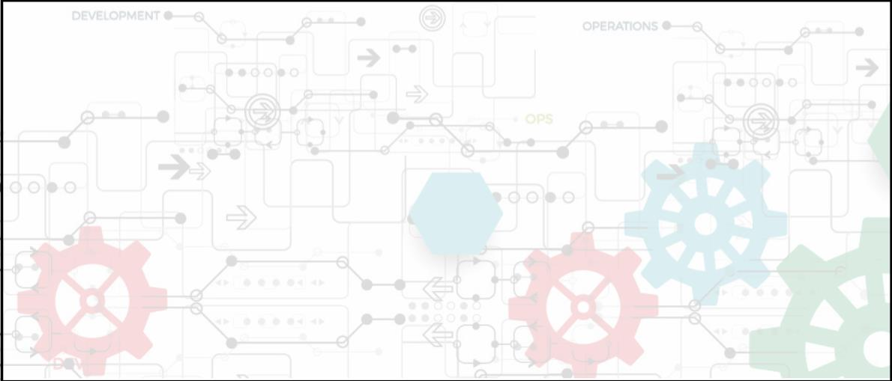


MODULE 1
Agile Practices
Facilitator Notes:
Welcome the participants and give them an overview of the module. Tell them that they
will learn about the ‘Agile Practices’ in this module.
You will learn about the ‘Agile Practices’ in this module.
At the end of this module, you will be able to:
● Learn Agile methodology
● Deﬁne software, history of software engineering, and
software development methodologies
● Identify the traditional software development models
● Discuss the waterfall model and classical waterfall model
● Understand about traditional IT organizations
● Learn about developers vs IT operations conﬂict
● Explain birth of Agile, and four values of the Agile manifesto
Copyright © 2019, Xebia Group. All rights reserved. This course is licensed to UPES
| 5

Slide 2

|
Facilitator Guide Clean Code: Software Craftsmanship
● Describe about Scrum, Scrum theory, Scrum values, Scrum roles, Scrum master, Scrum
sprints, beneﬁts of Scrum, etc.
● Describe planning and estimation, Agile planning, and its levels
● Deﬁne conditions of satisfaction and velocity
● List the various estimating techniques
● Discuss about soft skills in Agile
● Explain the Kanban model
Let us take a quick look at the topics that we will cover in this
module:
● Agile methodology
● Software, History of Software Engineering and Software
Development Methodologies
● Traditional Software Development Models
● Waterfall Model, Classical Waterfall Model
● Traditional IT Organizations
● Developers vs IT Operations Conﬂict
● Birth of Agile, Four Values of the Agile Manifesto
● Scrum, Scrum Theory, Scrum Values, Scrum Roles, Scrum Master Scrum Sprints, Beneﬁts
of Scrum
● Planning and Estimation, Agile Planning, Levels of Agile Planning
● Conditions of Satisfaction, Velocity
6 |
Copyright © 2019, Xebia Group. All rights reserved. This course is licensed to UPES

Slide 3

|
Module 1 Agile Practices
● Estimating Techniques
● Soft Skills in Agile
● Kanban Model
1.1 Agile Methodology - Evoluꢀon
The following diagram illustrates the evolution of Agile methodology.
Industry frustrations in the 1990s
due to the deficiencies in
traditional methods of software
development.
‘Application Development Crisis’
or ‘Application Delivery Lag’.
Change in business, functional
requirements, systems and
client’s needs over time.
Cancellation of Projects in
pipeline.
Facilitator Notes:
● Ask the participants what they think, triggered the rise of Agile.
● Note down, what they say on the slide.
● Then show the boxes with the reasons.
Around the 1990s, the software development industry was in a great crisis. Due to the
deﬁciencies in the traditional software development approaches, there was an enormous lag
in time between the functional requirements requested by the customers and the delivery
of technology. At that time, it was estimated that the time period between business need
validation and the delivery of software/application was around three years. Some businesses
faced a lag of more than three years.
Copyright © 2019, Xebia Group. All rights reserved. This course is licensed to UPES
| 7

Slide 4


|
Facilitator Guide Clean Code: Software Craftsmanship
Three years is a more than suﬃcient time period for businesses, systems and requirements
to change. This resulted in the cancellation of projects mid-way. Completed projects failed to
make sense, because of the change in requirements over time.
Industry experts were forced to develop alternative methods of software development and
delivery, and this laid the foundation for the birth of Agile.
1.2 Soꢁware
Following are the key details of the software:
● A software is an organized information in the form of operating
systems, programs, utilities and applications that enable a
computer to work.
● Software comprises a set of machine-readable instructions that directs a computer’s
processor to perform speciﬁc operations.
● It includes computer programs, libraries and their associated documentation.
● Software programs are stored as ﬁles on a storage device such as hard disk, DVD or
memory sticks. When needed, they are loaded into the computer’s memory (RAM).
● In a nutshell, a software is everything that governs the functioning of a computer, an
interface between computers and humans who use them.
Facilitator Notes:
Explain participants what a software is and why it is required.
Computers and mobile phones have become an inevitable part of everyone’s life. On a daily
basis, all of us interact with operating systems, spreadsheets, documents, games, videos
and so many other applications. Ever wondered how all these things function? Behind
each and every application that we use, lies a software built by developers, on multiple
diﬀerent programming languages. Let’s look at what a software is, how it works, diﬀerent
types of software, the history of software engineering and the diﬀerent methods of software
development.
8 |
Copyright © 2019, Xebia Group. All rights reserved. This course is licensed to UPES

Slide 5
|
Module 1 Agile Practices
What is a Software?
A software can be deﬁned as an organized information in the form of operating systems,
programs, utilities and applications that enable a computer to work. A software consists of
carefully-organized instructions and code written by programmers in any of the diﬀerent
programming languages. A software is diﬀerent from the physical hardware (from which the
computer system is built), in a way that it contains the data or instructions which enable the
system to perform. A software includes computer programs, libraries and other related non-
executable data, such as online documentation or digital media.
Software controls the computer (operating systems), the communication of information
(networks), and the creation and control of other programs (software tools and environments).
The software also transforms information in diﬀerent ways as producing, managing, acquiring,
modifying, displaying, or transmitting information, whether it is a computer desktop or a mobile
phone.
A computer requires both hardware and software for its function. Without either, the other
might not work on its own. For example, without a physical device like desktop computer or
mobile phone you will not be able to use the Internet, or an operating system, the browser
could not run on the computer.
In today’s context, software takes on a dual role, it is a product and at the same time, the
vehicle for delivering the product. As a product, it delivers the computing potential embodied
by computer hardware or more broadly, by a network of computers that are accessible by
local hardware. Whether it resides within a mobile phone or operates inside a mainframe
computer, the software is an information transformer—producing, managing, acquiring,
modifying, displaying, or transmitting information that can be as simple as a single bit or as
complex as a multimedia presentation derived from data acquired from dozens of independent
sources. As the vehicle used to deliver the product, software acts as the basis for the control
of the computer (operating systems), the communication of information (networks), and the
creation and control of other programs (software tools and environments).
Copyright © 2019, Xebia Group. All rights reserved. This course is licensed to UPES
| 9

Slide 6
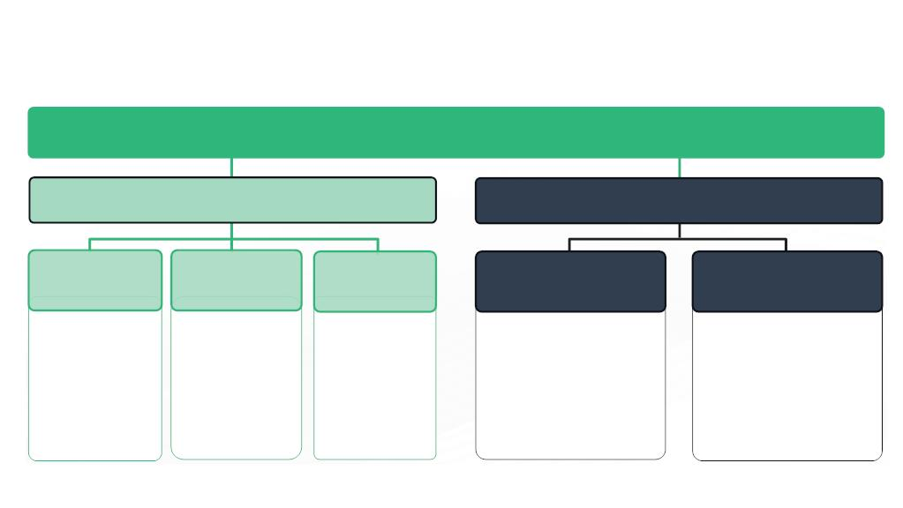
|
Facilitator Guide Clean Code: Software Craftsmanship
1.2.1 Different Types of Software
Software
System Software
Application Software
System
Management
Programs
System
Support
Programs
System
Development
Programs
General Purpose
Applications
Special Purpose
Applications
 Operating systems
 Operating
Environments
 Database
Management
Systems
 Telecommunication
Monitors
 System utilities
 Performance
monitors

Programming
Language
Translators
Programming
environments
 Word Processing
 Accounting software
 Reservation systems
 Marketing – Sales Analysis, etc.
 Finance – Capital Budgeting,
etc.
 Security monitors

 Electronic Spreadsheets
 Database Management
Systems
 Graphics
 Integrated packages
 Computer-Aided
Software
Engineering
(CASE) Packages
Facilitator Notes:
Explain participants about the diﬀerent types of software.
We’ve now learnt that a software is needed for functioning of computer systems. We will now
have a look at the diﬀerent types of software.
There are two major categories of software, based on the purpose of use:
1. System Software
2. Application Software
System Software
System software is the one that operates the computer hardware and enables the functioning
of the computer system. It includes operating systems, device drivers, diagnostic tools,
servers, utilities, etc. The major purpose of system software is to insulate the application
programmer to the extent possible from the details of the particular computer complex
being used, especially memory and other hardware features, such as accessory devices as
communications, printers, readers, displays, keyboards, etc. System software provides the
platform for running application software. Systems software area is characterized by heavy
10 |
Copyright © 2019, Xebia Group. All rights reserved. This course is licensed to UPES

Slide 7
|
Module 1 Agile Practices
interaction with computer hardware; heavy usage by multiple users; concurrent operation
that requires scheduling, resource sharing, and sophisticated process management; complex
data structures; and multiple external interfaces.
System software in turn can be classiﬁed into:
a) System Management Programs
Programs that are responsible for the functioning and management of computer systems. These
are the ones that run and manage the resources and provide common services for other software
that run on top of them. System management programs include:
● Operating systems
● Operating Environments
● Database Management Systems
● Telecommunication Monitors
b) System Support Programs
It is a program that supports, or facilitates the smooth and eﬃcient execution of various programs
and operations of a computer. System support programs include:
● System utilities
● Performance monitors
● Security monitors
c) System Development Programs
System development programs have the instructions to create and maintain computer systems.
These include:
● Programming Language Translators
● Programming environments
● Computer-Aided Software Engineering (CASE) Packages
Copyright © 2019, Xebia Group. All rights reserved. This course is licensed to UPES
| 11

Slide 8
|
Facilitator Guide Clean Code: Software Craftsmanship
Application software
A group of programs designed to carry out a single or a group of related tasks. Application
software is actually a subclass of computer software, which leverages the capabilities of
a computer directly to a task that the user wishes it to perform. Application software is
looked upon as a software as well as its implementation. Application software is stand-alone
programs that solve a speciﬁc business need. Applications in this area process business or
technical data in a way that facilitates business operations or management/technical decision
making. In addition to conventional data processing applications, application software is used
to control business functions in real time.
Application software can be broadly classiﬁed into:
a) General purpose software: General purpose application software is a type of application that
can be used for a variety of tasks. It is not limited to one particular function. Diﬀerent types of
general purpose software include:
● Word processing software
● Electronic spreadsheets
● Database managers
● Presentation graphics
● Integrated packages
b) Special purpose software: Special purpose application software is a type of software created to
execute one speciﬁc task. Some examples of special purpose software include:
● Accounting software
● Reservation systems
● Marketing – Sales Analysis, etc.
● Finance – Capital Budgeting, etc.
12 |
Copyright © 2019, Xebia Group. All rights reserved. This course is licensed to UPES

Slide 9

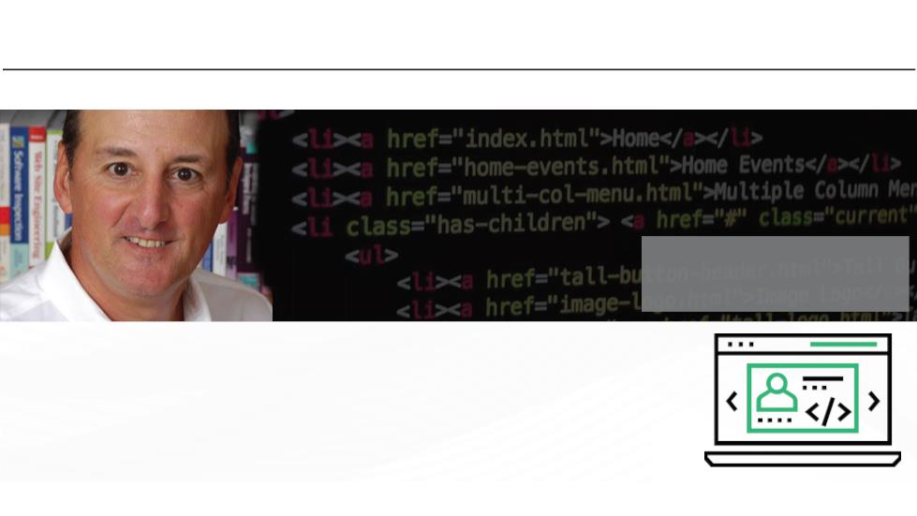
|
Module 1 Agile Practices
What did You Grasp?
1. Which of the following is not a system software?
A) Operating software
B) Performance monitor
C) Database management systems
D) Word processing software
Facilitator Notes:
Tell the participants that they will be going through a knowledge check question.
Answer:
1. d. Word processing software
1.3 Deꢂniꢀon of Digital Transformaꢀon
Roger S. Pressman
President of R.S. Pressman & Associates
“Software engineering is the technology that encompasses a process,
a set of methods and an array of tools that allow professionals to build
high quality computer software.”
Source adopted from “Software Engineering: A Practitioner's Approach” written by Roger S. Pressman
Copyright © 2019, Xebia Group. All rights reserved. This course is licensed to UPES
| 13

Slide 10
|
Facilitator Guide Clean Code: Software Craftsmanship
Facilitator Notes:
Give a brief introduction of software engineering and provide some deﬁnitions.
Software engineering is a detailed study of engineering to the design, development and
maintenance of software. Software is important because it aﬀects nearly every aspect of our
lives and has become pervasive in our commerce, culture and everyday activities. Software
engineering is important because it enables us to build complex systems in a timely manner
and with high quality.
Definition of Software Engineering
● IEEE Standard Glossary of Software Engineering Terminology: “The application of
a systematic, disciplined, quantiﬁable approach to the development, operation and
maintenance of software.”
● IEEE Systems and software engineering - Vocabulary: “The systematic application
of scientiﬁc and technological knowledge, methods, and experience to the design,
implementation, testing, and documentation of software.”
● Deﬁnition by Roger S. Pressman (American software engineer, author and consultant, and
President of R.S. Pressman & Associates): “Software engineering is the technology that
encompasses a process, a set of methods and an array of tools that allow professionals
to build high quality computer software.”
● Deﬁnition by Ian Sommerville (British academic and author of text books): “An engineering
discipline that is concerned with all aspects of software production.”
As per these deﬁnitions, a software may be very complex and beyond the handling of a single
individual. As a result, a number of people are expected to work on the pieces of a software
product in a cooperative manner. Also, a software product can have many versions which
need to be managed. We can say, Software engineering is also a management activity in
addition to the implementation activity.
14 |
Copyright © 2019, Xebia Group. All rights reserved. This course is licensed to UPES

Slide 11
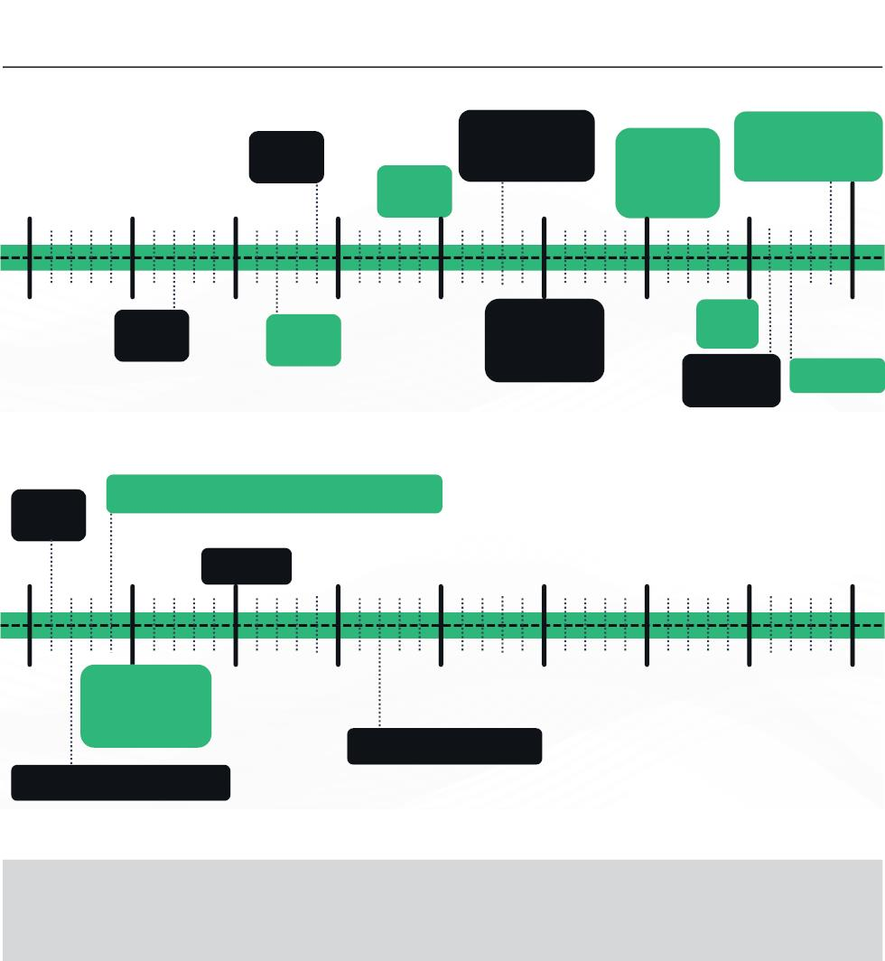
|
Module 1 Agile Practices
1.4 History of Soꢁware Engineering
(1964)
BASIC
(1970)
(1973) C (and the
Unix operating
system)
 (1980)
Ada
 (1980)
 (1989-90) The
Web is born
 (1990) Haskell
1955
1965
Pascal
1975
Smalltalk 1985
1950
(1957)
Fortran
1960
(1962)
Cobol
1970
(1975) First
interactive PC
(Xerox
1980
(1985)
C++
1990
PARC's Alto)
(1986)
Objective-C
(1987) Perl
(1991)
Python
(1994) Netscape, Yahoo, and Amazon launch
1995
(2000) C#
2005
2015
2025
1990
 (1995) Java
 (1995) Ruby
 (1995)
2000
2010
2020
2030
JavaScript
(2007) iPhone I released
(1992) Linux is open-sourced
Facilitator Notes:
Explain to participants the classiﬁcation of software engineering in various areas.
The history of software engineering is rich and fascinating. Software engineering began
when computer programs were just instructions to manipulate a physical device and it has
crossed several key turning points that led to the commercialization and the consumerization
of computing technology.
Copyright © 2019, Xebia Group. All rights reserved. This course is licensed to UPES
| 15

Slide 12
|
Facilitator Guide Clean Code: Software Craftsmanship
Initial Days of Software
It was the computer scientist Tom Kilburn, who wrote the world’s ﬁrst piece of software,
run in 1948 at the University of Manchester in England. Kilburn and his colleague Freddie
Williams had built one of the earliest computers, the Manchester Small-Scale Experimental
Machine (also known as the “Baby”). The SSEM was programmed to perform mathematical
calculations using machine code instructions. This ﬁrst piece of software took 52 minutes to
correctly compute the greatest divisor of 2 to the power of 18 (262,144).
Back in the late ‘50’s and early ‘60’s, the programmers didn’t interact directly with computing
devices. They delivered their programs by hand to technicians and picked up the results
hours later, after the programs were batch processed with many others. Thus, early tasks
were typically geared towards mathematical computation, which required a very limited
feedback loop.
For decades after this groundbreaking event, computers were programmed with punch cards
in which holes denoted speciﬁc machine code instructions. Fortran, one of the very ﬁrst higher-
level programming languages, was originally published in 1957 by IBM, for mathematical and
scientiﬁc computing. The next year, statistician John Tukey coined the word ‘software’ in an
article about computer programming. Another programming language Cobol, was released
by the US Department of Defense in 1962 for use in business applications. Other pioneering
programming languages like BASIC, Pascal and C arrived over the next two decades.
The Software Crisis
The transition to using a time-sharing model instead of batch processing for running programs
was perhaps most signiﬁcant of all because it led to a rapid growth in computing applications.
Unfortunately, projects consistently failed to deliver reliably, on time and on budget.
Practitioners were forced to admit that they lacked the proper best practices to implement
and produce software at scale commercially. They called it the ‘Software Crisis’.
Foundations of Software Engineering
The software crisis period taught a great lesson that designing complex software systems
would require better tools and approaches than were available at the time. A conference
was convened in 1968 to ﬁnd a solution. It was at this conference, where the term ‘Software
Engineering’ found its roots. The conference sought to apply the best practices of project
16 |
Copyright © 2019, Xebia Group. All rights reserved. This course is licensed to UPES

Slide 13
|
Module 1 Agile Practices
management and production to software. As a result, they produced a report which deﬁned
the foundations of software engineering. The early 70’s saw the emergence of key ideas in
systems thinking which allowed engineers to break these giant projects into modular (and
much more manageable) pieces that communicated via interfaces.
The Personal Computing Era
In the 1970s and 1980s, software became a boom with the arrival of personal computers.
C, the general-purpose programming language was originally developed by Dennis Ritchie
between 1969 and 1973 at Bell Labs, and used to re-implement the Unix operating system.
Apple released Apple II, its revolutionary product, to the public in April 1977. VisiCalc, the ﬁrst
spreadsheet software for personal computing, was wildly popular and known as the Apple
II’s killer app. The software was written in a specialized assembly language and appeared in
1979. The IBM PC was ﬁrst launched in 1981. The next year, Time magazine selected the
personal computer as its Man of the Year.
Software for productivity and business dominated these early stages of personal computing
as well. Many signiﬁcant software applications, including AutoCAD, Microsoft Word and
Microsoft Excel, were released in the mid-1980s. Between 1980 and 1995, the major
programming languages and frameworks like C++, Objective C, Perl, Haskell, Python and
Java were released, and this period brought a major breakthrough in the industry.
With the advent of the Internet, open-source software, another major innovation in the history
of software development, ﬁrst entered the mainstream in the 1990s. The Linux kernel, which
became the basis for the open-source Linux operating system, was released in 1991. Interest
in open-source software spiked in the late 1990s, after the 1998 publication of the source
code for the Netscape Navigator browser, mainly written in C and C++. Also, noteworthy is
the release of Java by Sun Microsystems in 1995.
Mobile Computing
In 1993, IBM ﬁrst released the smartphone and in 1996, Palm OS became a hit in the
market. In 1999, RIM released the very ﬁrst Blackberry 850 device. In 2007, Apple changed
computing with the release of the iPhone. It was only after this period, Mobile computing and
mobile applications began to explode. Mobile apps use Swift (iOS) and Java (Android) as the
development languages.
Copyright © 2019, Xebia Group. All rights reserved. This course is licensed to UPES
| 17

Slide 14
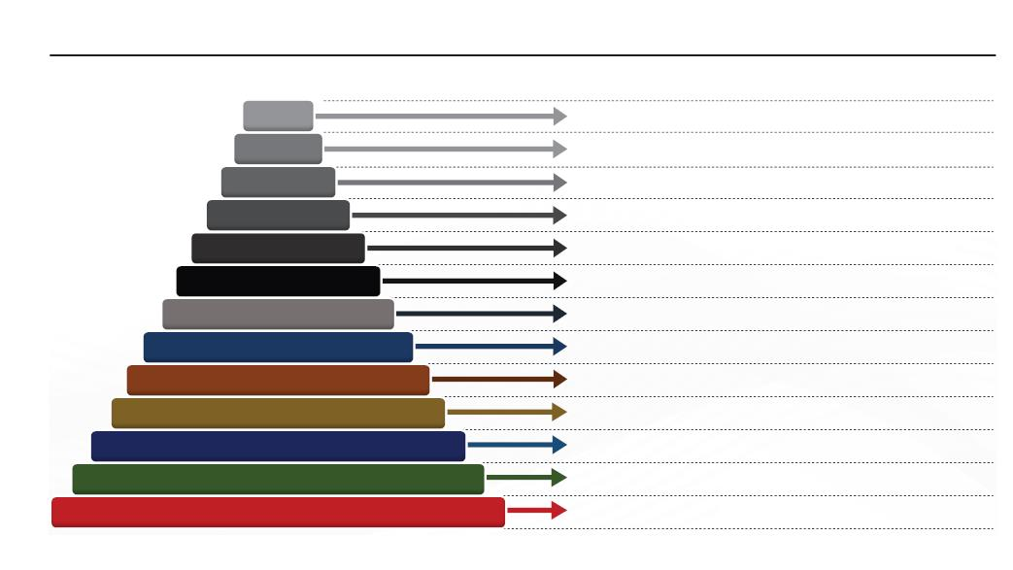
|
Facilitator Guide Clean Code: Software Craftsmanship
Some programming languages, like C and Cobol, have survived the test of time and are still in
use. Other languages, such as Java and Python, are somewhat younger and have been used
in countless software development projects. Still others, such as Apple’s Swift programming
language for iOS or Go Open source, are relatively new and exciting.
Let’s look at some of the traditional ways of software development.
1.5 History of Soꢁware Development Methodologies
2014
2011
Introduction of LeSS (Largs-scale Scrum);
Scale Agile Framework (SAFe)
2010
Kanban book published
2009
DevOps becomes popular through series of
DevOpsDays
2003
Lean software development book published
2001
Agile Manifesto published
1999
Extreme Programming paper released
Rational Unified Process (RUP)
1996-1998
1995
Scrum methodology paper published
Spiral Development model; Introduction of
Scrum concept
1986
US Dept of Defense normalizes Waterfall
methodology
1985
First formal description of Waterfall
methodology
1956
Gantt chart for project management
1910
Facilitator Notes:
Explain brieﬂy about the sequence of events in the history of software development.
Go through the above infographic to understand the major milestones in the history of software
development methodologies.
1.6 Tradiꢀonal Soꢁware Development Models
Many life cycle models have been proposed so far, with their own advantages and
disadvantages. A few important traditional software development models are as follows:
18 |
Copyright © 2019, Xebia Group. All rights reserved. This course is licensed to UPES

Slide 15

|
Module 1 Agile Practices
Classic
Waterfall Model
Gated Waterfall
Model
V-Shaped
Model
Prototyping
Model
Spiral
Model
Facilitator Notes:
Explain the participants that ‘Software development life cycle (SDLC)’ consists a series of
phases that provides a common understanding of the software building process. Let the
participants know that they will also learn about - How software is realized and developed
from the business understanding and requirements elicitation phase to convert these
business ideas and requirements into functions and features until its usage and operation
to achieve the business needs.
Traditionally, the software was designed by organizing the development process into a series
of phases, that will happen one after the other. The output of one phase will be the input for
the next phase. In most of the cases, it is unidirectional, starting from design requirement to
development to deployment, with no reversal in the ﬂow. This meant that any change in the
requirement caused the process to start all over again, and any bug or error caused serious
issues in terms of time, eﬀort and cost.
The following list gives an overview of a few traditional software development models. Each
model comes with its own set of advantages or disadvantages. A few important and commonly
used life cycle models are as follows:
●
Classical Waterfall Model: The waterfall model emphasizes that a logical progression of steps
be taken throughout the software development life cycle (SDLC), much like the cascading steps
down an incremental waterfall. While the popularity of the waterfall model has waned over recent
years in favor of more agile methodologies, the logical nature of the sequential process used in
the waterfall method cannot be denied, and it remains a common design process in the industry.
The steps involved in the classical waterfall model are as follows:
○ Requirements
○ Analysis
Copyright © 2019, Xebia Group. All rights reserved. This course is licensed to UPES
| 19

Slide 16
|
Facilitator Guide Clean Code: Software Craftsmanship
○ Design
○ Coding
○ Testing
○ Operations/Maintenance
●
●
Gated Waterfall Model: In a gated waterfall model, there is a quality gate between the phases.
The quality gate is based on the review and acceptance of artifacts. The feedback can also go
back to any phase. The gated waterfall model is explained in a later section.
V-shaped Model: An extension to the waterfall model. The process ﬂow doesn’t move down in a
linear way. Instead, the process ﬂow bends and moves upwards after implementation and coding
phase, to form the typical V-shape. The major diﬀerence between waterfall model and V-model is
that test planning and designing happen in early stages well before coding. This makes the model
more successful than the classic waterfall model, as it saves a lot of time. This model suits well for
small projects, where requirements are clearly deﬁned and easily understood. The steps involved
in this model are as follows:
○ Requirements
○ System design
○ Architecture design
○ Module design
○ Implementation/Coding
○ Unit testing
○ Integration testing
○ System testing
○ Acceptance testing
●
Prototyping Model: The Prototyping Model is one of the most popularly used Software
Development Life Cycle Models (SDLC models). This model is used when the customers do not
know the exact project requirements beforehand. In this model, a prototype of the end product
is ﬁrst developed, tested and reﬁned as per customer feedback repeatedly till a ﬁnal acceptable
prototype is achieved which forms the basis for developing the ﬁnal product. There are two
approaches:
○
Rapid throwaway prototyping: Prototypes are ﬁrst created, but they will not become a part
of the ﬁnally delivered software.
○
Evolutionary prototyping: Prototypes gradually evolve as the ﬁnal product by means of an
iterative incorporation of user feedback.
20 |
Copyright © 2019, Xebia Group. All rights reserved. This course is licensed to UPES

Slide 17

|
Module 1 Agile Practices
○
○
Incremental prototyping: The ﬁnal product is built as individual prototypes. In the end, the
prototypes are merged in an overall design to get the ﬁnal product.
Extreme prototyping: Most commonly used for developing web applications. It involves three
phases:
■
■
Phase 1: A static prototype is built that mainly contains HTML pages
Phase 2: Screens are programmatically converted to a fully functional product using a
simulated services layer.
■
Phase 3: Services are implemented during this phase.
●
Spiral Model: The Spiral Model is a software development methodology that aids in choosing the
optimal process model for a given project. It combines aspects of the incremental build model,
waterfall model and prototyping model. The Spiral Model is concerned primarily with risk awareness
and management. Spiral model is distinguished by a set of six invariant characteristics:
○ Deﬁne artifacts concurrently
○ There are four essential spiral tasks
○ Risk determines level of eﬀort
○ Risk determines degree of details
○ Use the anchor point milestones
○ Focus on the system and its life cycle
What did You Grasp?
1. In which of the following prototyping methods, initially created
prototypes will not become part of the final version of the software?
A) Extreme prototyping
B) Rapid throwaway prototyping
C) Evolutionary prototyping
D) Incremental prototyping
2. Which of the following statements about Spiral model is true?
A) Define artifacts sequentially
B) There are four essential spiral tasks
C) Risk determines level of effort
D) Risk determines degree of details
Copyright © 2019, Xebia Group. All rights reserved. This course is licensed to UPES
| 21

Slide 18

|
Facilitator Guide Clean Code: Software Craftsmanship
Facilitator Notes:
Tell the participants that they will be going through a knowledge check question.
Answers:
1. b. Rapid throwaway prototyping
2. a. Deﬁne artifacts sequentially
1.7 Waterfall Model
Analysis
Design
Implementation
Testing
Deployment
Maintenance
Facilitator Notes:
Let the participants know that in the classical waterfall model the development process
begins only if the previous phase is complete. Explain to the participants why this model
has been so popular.
The most popular way of developing a software is the ‘THE CLASSICAL WATERFALL’ model
. It is the ﬁrst SDLC model, introduced to describe the software development, in late 1950
and became popular in 1970’s by the ﬁrst formal description of the waterfall model cited in
an article by Winston W. Royce though the term ‘waterfall’ was coined by Bell and Thayer in
1976.
In waterfall model, the entire software development process undergoes diﬀerent phases,
namely requirement details/analysis, design, coding and testing, system testing and
integration, deployment and maintenance.
22 |
Copyright © 2019, Xebia Group. All rights reserved. This course is licensed to UPES

Slide 19
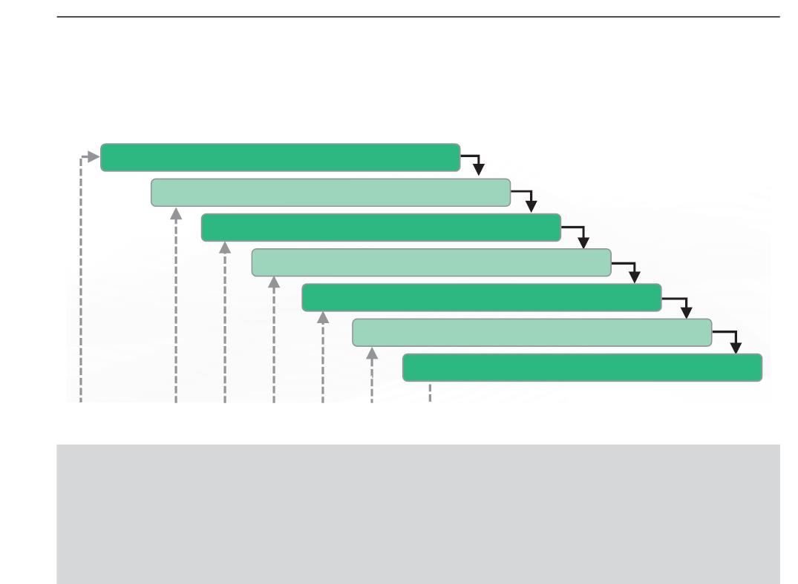
|
Module 1 Agile Practices
A team of experts and trained people in each department handle diﬀerent phases of the
Waterfall model. For example, business and requirements analysis department, software
engineering department, development and programming department, quality assurance (QA)
department, and technical support department.
1.8 Classical Waterfall Model
In the waterfall approach, the outcome of one phase acts as the input for the next phase
sequentially. The following picture illustrates the ﬂow of steps in the waterfall model.
Feasibility Study
Requirement Analysis and Specification Design
Design Phase
Coding and Unit testing
Integration and system testing
Deployment
Maintenance
Facilitator Notes:
Let the participants know that in classical waterfall model the development process begins
only if the previous phase is complete. Explain to the participants why this model has
been so popular.
In the waterfall approach, the whole process of software development is divided into separate
phases. The outcome of one phase acts as the input for the next phase sequentially. This
means that any phase in the development process begins only if the previous phase is
complete. The waterfall model is a sequential design process in which progress is seen as
ﬂowing steadily downwards (like a waterfall) through the phases of conception, initiation,
analysis, design, construction, testing, production/implementation and maintenance.
Copyright © 2019, Xebia Group. All rights reserved. This course is licensed to UPES
| 23

Slide 20
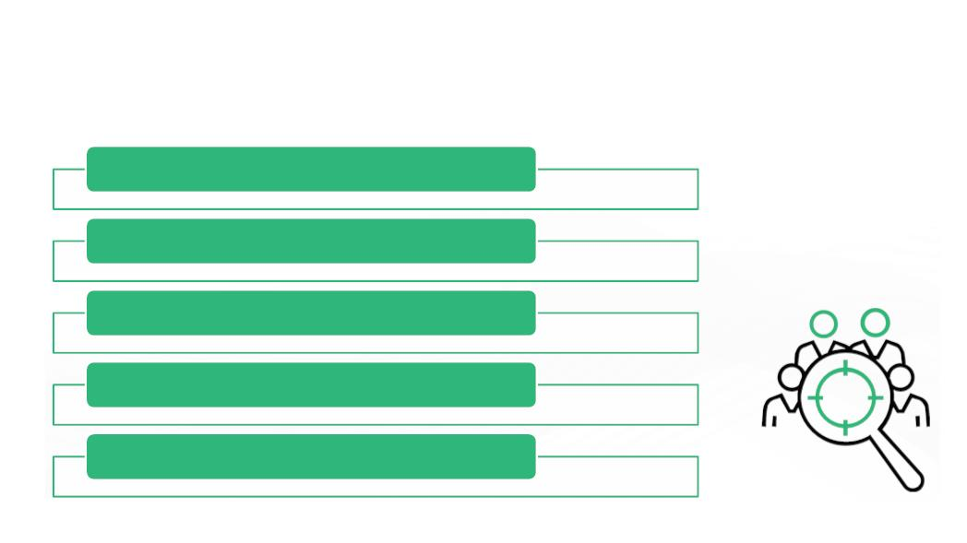
|
Facilitator Guide Clean Code: Software Craftsmanship
As the Waterfall Model illustrates the software development process in a linear sequential
ﬂow; hence it is also referred to as a Linear-Sequential Life Cycle Model.
The sequence of steps in the waterfall model is as follows:
1. The ﬁrst and foremost stage is the study of resources, technical & ﬁnancial feasibility.
2. Requirement Analysis and speciﬁcation design
3. Design Phase
4. Coding and Unit testing
5. Integration and system testing
6. Maintenance
1.8.1 First Stage – Feasibility Study
The following activities are covered during the feasibility study phase:
Financial Feasibility
Technical Feasibility
Client Visit
Study Of Input-output Data
Case Study
Facilitator Notes:
Explain the participants the objective of feasibility study and how it is helpful to determine
the durability of the project.
24 |
Copyright © 2019, Xebia Group. All rights reserved. This course is licensed to UPES

Slide 21
|
Module 1 Agile Practices
The main aim of feasibility study is to determine whether it would be ﬁnancially and technically
feasible to develop the product. At ﬁrst project managers or team leaders ﬁgure out a rough
understanding of what is required to be done by visiting the client . They study diﬀerent
input and output data to be produced by the system. They study the required processing
to be done on these data and look at the various constraints and eﬀects on the behavior of
the system. After understanding the problem (if any) they investigate the diﬀerent available
solutions.
Then they examine each of the solutions in terms of what kind of resources required, what
would be the cost of development and what would be the development time for each solution.
Based on this analysis they pick the best solution and determine whether the solution is
feasible ﬁnancially and technically. They check whether the customer budget would meet
the cost of the product and whether they have suﬃcient technical expertise in the area of
development. The following is an example of a feasibility study undertaken by an organization.
It is intended to give you a feel of the activities and issues involved in the feasibility study
phase of a typical software project.
Case Study:
A mining company named Galaxy Mining Company Ltd. (GMC) has mines located at various
places in India. It has about ﬁfty diﬀerent mine sites spread across eight states. The company
employs a large number of mines at each mine site. Mining being a risky profession, the
company intends to operate a special provident fund, which would exist in addition to the
standard provident fund that the miners already enjoy. The main objective of having the
special provident fund (SPF) would be quickly distributed some compensation before the
standard provident amount is paid. According to this scheme, each mine site would deduct
SPF installments from each miner every month and deposit the same with the CSPFC (Central
Special Provident Fund Commissioner). The CSPFC will maintain all details regarding the
SPF installments collected from the miners. GMC employed a reputed software vendor
Adventure Software Inc. to undertake the task of developing the software for automating the
maintenance of SPF records of all employees. GMC realized that besides saving manpower
on bookkeeping work, the software would help in speedy settlement of claim cases. GMC
indicated that the amount it can aﬀord for this software to be developed and installed is Rs.
1 million.
Copyright © 2019, Xebia Group. All rights reserved. This course is licensed to UPES
| 25

Slide 22

|
Facilitator Guide Clean Code: Software Craftsmanship
Adventure Software Inc. deputed their project manager to carry out the feasibility study. The
project manager discussed the matter with the top managers of GMC to get an overview of
the project. He also discussed the issues involved with the several ﬁeld PF oﬃcers at various
mine sites to determine the exact details of the project. The project manager identiﬁed two
broad approaches to solve the problem. One was to have a central database which could be
accessed and updated via a satellite connection to various mine sites. The other approach
was to have local databases at each mine site and to update the central database periodically
through a dial-up connection. These periodic updates could be done on a daily or hourly
basis depending on the delay acceptable to the GMC in invoking various functions of the
software. The project manager found that the second approach was very aﬀordable and more
fault-tolerant as the local mine sites could still operate even when the communication link to
the central database temporarily failed. The project manager quickly analyzed the database
functionalities required, the user-interface issues, and the software handling communication
with the mine sites. He arrived at a cost to develop from the analysis. He found that the
solution involving maintenance of local databases at the mine sites and periodic updating of
a central database was ﬁnancially and technically feasible. The project manager discussed
his solution with the GMC management and found that the solution was acceptable to them
as well.
1.8.2 Second Stage – Requirements Analysis and Specification Design
The two major activities carried out during the requirements analysis and speciﬁcation design
phase.
Requirements  All relevant information regarding the product is collected from the customer and users
gathering and
analysis
through interviews and discussions.
 All the ambiguities and contradictions are identified and resolved.
 User requirements are captured and organized into a Software Requirements
Requirements
specification
Specification (SRS) document.
 The main components of SRS are functional requirements, non-functional requirements
and goals for implementation.
 Very little information on top-level analysis and design is also included in this document.
26 |
Copyright © 2019, Xebia Group. All rights reserved. This course is licensed to UPES

Slide 23
|
Module 1 Agile Practices
Facilitator Notes:
Explain to participants, how in this phase, the expectations and goals of the project are
deﬁned, and risks are analyzed.
The aim of the requirements analysis and speciﬁcation phase is to understand the exact
requirements of the customer and to document them properly. This phase consists of two
distinct activities:
● Requirements gathering and analysis
● Requirements speciﬁcation
The aim of ‘requirements gathering’ is to collect all relevant information from the customer
regarding the product to be developed. Once this is done and clear understanding of the
customer requirements is available, then the incompleteness and inconsistencies are
removed. The requirements analysis activity is started by collecting all the relevant data
related to the product to be developed from the users of the product and from the customer
through interviews and discussions.
For example, to do the analysis of a business accounting software required by an
organization, the analyst should interview all the accountants of the organization to
assess their requirements and expectations. It is necessary to identify all ambiguities and
contradictions in the requirements as there is a possibility that the data collected may contain
several contradictions and ambiguities, since each user typically has only a partial and
incomplete view of the system. Once all ambiguities, inconsistencies, and incompleteness
have been resolved and all the requirements/expectations have been properly understood,
the requirements speciﬁcation activity can start.
This activity includes the steps to systematically capture and organize the user requirements
into a Software/hardware Requirements Speciﬁcation (SRS) document. The customer
requirements identiﬁed during the requirements gathering and analysis activity are organized
into an SRS document. The important components of this document are functional
requirements, the nonfunctional requirements, and the goals of the implementation.
Copyright © 2019, Xebia Group. All rights reserved. This course is licensed to UPES
| 27

Slide 24

|
Facilitator Guide Clean Code: Software Craftsmanship
1.8.3 Third Stage – Design Phase
The following activities are covered during the design phase:
● Creation of system design as per the requirements gathered during the previous phase,
i.e., based on SRS document
● Functionality of hardware and software are separated out and the software modules are
designed
● Deﬁnition of overall system architecture
● Documentation of design
There are two levels in the design phase:
Design Phases
High
level
design
Low
level
design
Facilitator Notes:
Explain to participants, how a blueprint is drawn up for the developers along with a plan
of meeting requirements.
The goal of the design phase is to transform the requirements speciﬁed in the SRS document
into a structure that is suitable for implementation in some programming language. In technical
terms, during the design phase the software architecture is derived from the SRS document.
The two phases of design are as follows:
●
High level design: High-Level Design (HLD) involves decomposing a system into modules, and
representing the interfaces and invocating relationships among modules. An HLD is referred to
as software architecture. A HLD document will usually include a high-level architecture diagram
28 |
Copyright © 2019, Xebia Group. All rights reserved. This course is licensed to UPES

Slide 25
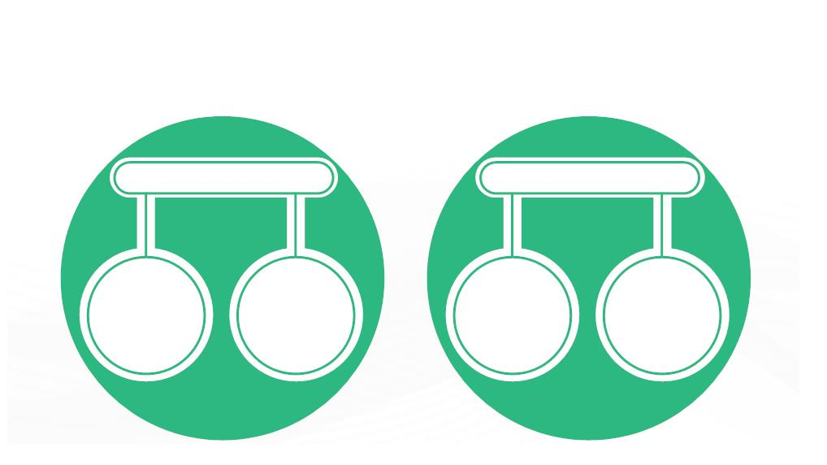
|
Module 1 Agile Practices
depicting the components, interfaces, and networks that need to be further speciﬁed or developed.
The document may also depict or otherwise refer to workﬂows and/or data ﬂows between
component systems.
●
Low level design: LLD, also known as a detailed design, is used to design internals of the
individual modules identiﬁed during HLD, i.e., data structures and algorithms of the modules are
designed and documented. Program speciﬁcations are covered under LLD. The LLD describes
each and every module in an elaborate manner so that the programmer can directly code the
program based on it. There will be at least one document for each module. The LLD will contain:
○ a detailed functional logic of the module in pseudocode
○ database tables with all elements, including their type and size
○ all interface details with complete API references (both requests and responses)
○ all dependency issues
○ error message listings
○ complete inputs and outputs for a module
1.8.4 Fourth Stage – Coding and Unit Testing
The following activities are covered during the code and unit testing phase:
IMPLEMENTATION
TESTING
Developing
Developing
the source
code
the
modules of
the
Testing of
modules
Debugging
the errors
program
Copyright © 2019, Xebia Group. All rights reserved. This course is licensed to UPES
| 29

Slide 26

|
Facilitator Guide Clean Code: Software Craftsmanship
Facilitator Notes:
Let the participants know that this phase is called as development, implementation or
coding and how the development takes place.
This stage is also called the implementation phase. This stage involves the coding and unit
testing of software development and to translate the software design into source code. Each
component of the design is applied as a program module. The end-product of this phase
is a set of program modules that have been being tested individually to ensure the correct
working of all the individual modules. The testing of each module in isolation is the most ideal
way to debug the errors at this stage.
1.8.5 Fifth Stage – Integration and System Testing
The following activities are covered during the integration and system testing phase:
Integration in
Steps of
Integration
Planned
Manner
Addition of
Modules
System
Testing
Facilitator Notes:
Emphasize the importance of this stage to participants and how it ensures that the product
meets the client’s requirements.
30 |
Copyright © 2019, Xebia Group. All rights reserved. This course is licensed to UPES

Slide 27

|
Module 1 Agile Practices
Once the modules have been coded and unit tested, integration of diﬀerent modules is
undertaken. During the integration and system testing phase, the modules are integrated in
a planned manner. The diﬀerent modules making up a software product are almost never
integrated in one shot. Integration is normally carried out progressively over a number of
steps. During each integration step, the partially integrated system is tested and a set of
previously planned modules is adds to it. Finally, when all the modules have been successfully
integrated and tested, system testing is carried out to ensure that the developed system
conforms to its requirements laid out in the SRS document.
This is a level of software testing where a complete and integrated software is tested. The
various tests may include the following:
Alpha (α ) -
Testing
(Development
team)
Beta (β) -
Testing (set of
customers)
Acceptance
Testing
(customers)
Facilitator Notes:
Explain the participants about the diﬀerent categories of system tests.
System testing usually comprises of three diﬀerent kinds of testing activities:
1. α – testing: It is the system testing carried out by the development team.
2. β – testing: It is the system testing carried by a friendly set of customers.
3. Acceptance testing: It is the system testing performed by the customer himself after the product
delivery to determine whether to accept or reject the delivered product.
Copyright © 2019, Xebia Group. All rights reserved. This course is licensed to UPES
| 31

Slide 28


|
Facilitator Guide Clean Code: Software Craftsmanship
System testing is normally carried out in a planned manner according to the system test
plan document. The system test plan identiﬁes all testing related activities to be performed,
mentioning the schedule of testing, and deﬁning the resources. This step also includes all
the test cases and the expected outputs for each test case. After integrating the unit tested
code, it is made sure that it works well, as expected and error-free. All the functional and non-
functional testing activities are performed to check whether the system meets the requirement
perfectly. The progress on testing is tracked through tools like traceability metrics and ALM.
Finally, the progress report of testing activities is prepared.
1.8.6 Sixth Stage – System Deployment and Maintenance
The following activities are covered during the system deployment and maintenance phase.
● Product Deployment
● Development and Maintenance
Maintenance
● Corrective Maintenance
● Perfective Maintenance
● Adaptive Maintenance
Facilitator Notes:
Explain to the participants that the product is implemented according to the agreed-
upon requirements and one more round of testing and veriﬁcation should be done after
implementation.
Once the functional and non-functional testing is completed, the product is deployed in the
customer environment or released in the market.
Maintenance of any software product requires much eﬀort than the eﬀorts put in to develop
the product. Researches conﬁrm that the relative eﬀort of development of a typical software
product to its maintenance eﬀort is roughly in the 40:60 ratio.
32 |
Copyright © 2019, Xebia Group. All rights reserved. This course is licensed to UPES

Slide 29
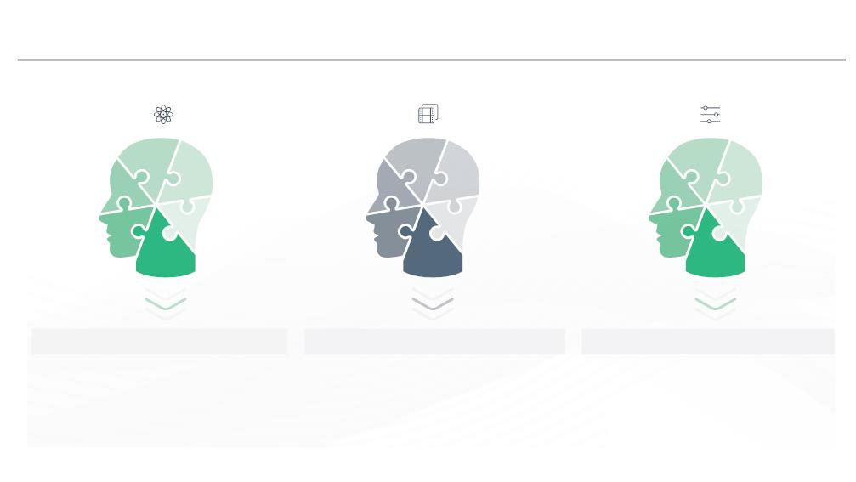
|
Module 1 Agile Practices
Maintenance involves performing any one or more of the following three kinds of activities:
a) Corrective maintenance: Correcting errors which were left undiscovered during the product
development phase is the part of maintenance
b) Perfective maintenance: Improving the implementation of the system and enhancing the
functionalities of the system according to the customer’s requirements. This is done to alter
attributes or improve performance.
c) Adaptive maintenance: Porting the software to work in a new environment. For example, porting
may be required for the smooth running of the software to work on a new computer system or with
a new operating system. The defects uncovered during live use of the software are also taken
care of in the maintenance stage.
1.9 Advantages of Waterfall Model
Discipline
Time and Cost Effective
Quality Improvement
Every phase has a defined start and end
point. The progress can be distinctly
identified by both, the client and the
software developer, through the use of
milestones.
The emphasis on requirements and
design, before writing the
codes/programs ensure the minimal
wastage of time, effort and cost and
decreases the risk of slipping of schedule.
The flaws can be easily caught and
taken care of at the design stage, much
earlier than the testing stage.
Facilitator Notes:
Explain the characteristics of Waterfall Model. There are many reasons why a waterfall
model has been so popular over the years few are listed on the slide.
The central idea of the waterfall model is to spend the majority of time, money and eﬀort up
front: 20-40% in the ﬁrst two phases, 30-40% on coding/development, and the rest during
implementation and maintenance.
1. Discipline: Every phase has a deﬁned start and end point. The progress can be distinctly identiﬁed
by both, the client and the software developer, through the use of milestones.
Copyright © 2019, Xebia Group. All rights reserved. This course is licensed to UPES
| 33

Slide 30
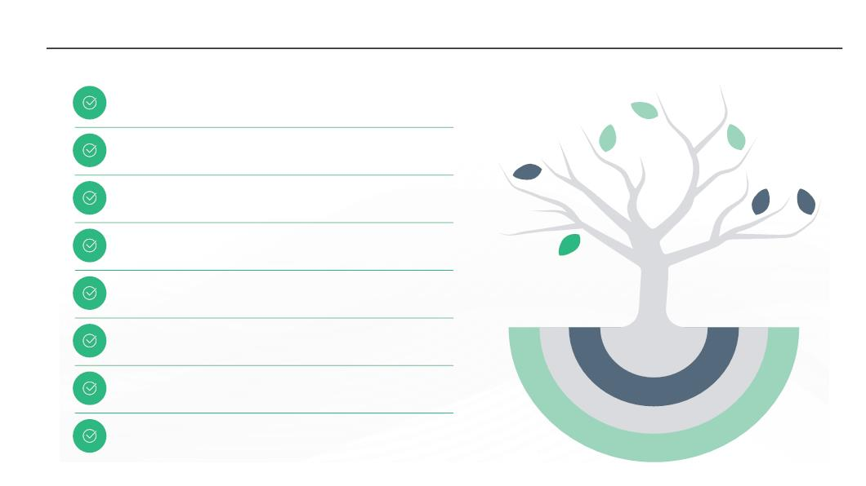
|
Facilitator Guide Clean Code: Software Craftsmanship
2. Time and cost eﬀective: The emphasis on requirements and design, before writing the codes/
programs ensures the minimal wastage of time, eﬀort and cost and decreases the risk of slipping
of schedule.
3. Quality improvement: The ﬂaws can be easily caught and taken care of at the design stage,
much earlier than the testing stage.
1.10 Shortcomings of the Waterfall Model
Possibilities of errors
Not suitable for all projects
Implicit assumptions
High risk and uncertainty
Non-adaptive design constraints
Ignores mid-process user/client feedback
Delayed testing period
Makes changes difficult
Facilitator Notes:
Explain to participants that new software development models have been introduced,
since waterfall model had its own disadvantages. Discuss the shortfall of the waterfall
model.
Shortcomings of the waterfall model
It is assumed that no developmental error is ever committed by the engineers during any
of the life cycle phases in the classic waterfall model . However, in practical development
environments, large number of errors are committed in almost every phase of the life cycle.
The source of the defects can be many, such as due to oversight, wrong assumptions, use of
inappropriate technology, communication gap between the project engineers, etc. Following
are the disadvantages of the waterfall model:
34 |
Copyright © 2019, Xebia Group. All rights reserved. This course is licensed to UPES

Slide 31
|
Module 1 Agile Practices
● In waterfall model, bugs/errors are usually detected much later in the life cycle. For e.g.,
a defect might have gone unnoticed till the coding or testing phase. Once a defect is
detected, the engineers need to go back and rectify some of the work done during that
phase and the subsequent phases. Therefore, in any practical software development
work, it is not possible to strictly follow the classic waterfall model.
● This model is not good for those projects where the requirements keep changing.
● Implicit assumptions of that, the design can be translated into a product can be lead to
roadblock at a very late stage.
● Lack of adaptability across all stages of development is the most diﬃcult disadvantage
of the waterfall model. When a test in the ﬁfth stage explains a fundamental ﬂaw in the
design of the system, it requires a dramatic leap backward in stages of the process. In
the worst case, it leads to a devastating realization regarding the legitimacy of the entire
system. While most experienced teams and developers would argue that such revelations
shouldn’t occur if the system was properly designed in the ﬁrst place, not every possibility
can be accounted for, especially when stages are so often delayed until the end of the
process.
● Due to the strict incremental process that the waterfall model enforces, user or client
feedback is received only during the later stages of the development cycle. While project
managers can obviously enforce a process to step back to a previous stage due to an
unforeseen requirement or change coming from a client, it will be both costly and time-
consuming, for both the development team and the client.
● Waterfall strictly introduces testing quite late into the cycle. Most bugs or even design
issues won’t be discovered until very late in the process, but it also encourages poor coding
practices that lack enthusiasm and determination, since testing is only an afterthought.
● Waterfall is based on steps that keeps the teams strictly moving in a forward direction,
there’s no room for unplanned changes or updates. If the team has strictly followed the
waterfall model nearly to the end of the project, and faces a sudden and unexpected
change in terms of goals or scope, pivoting will become mighty diﬃcult. Much of the work
done so far may go useless.
Copyright © 2019, Xebia Group. All rights reserved. This course is licensed to UPES
| 35

Slide 32
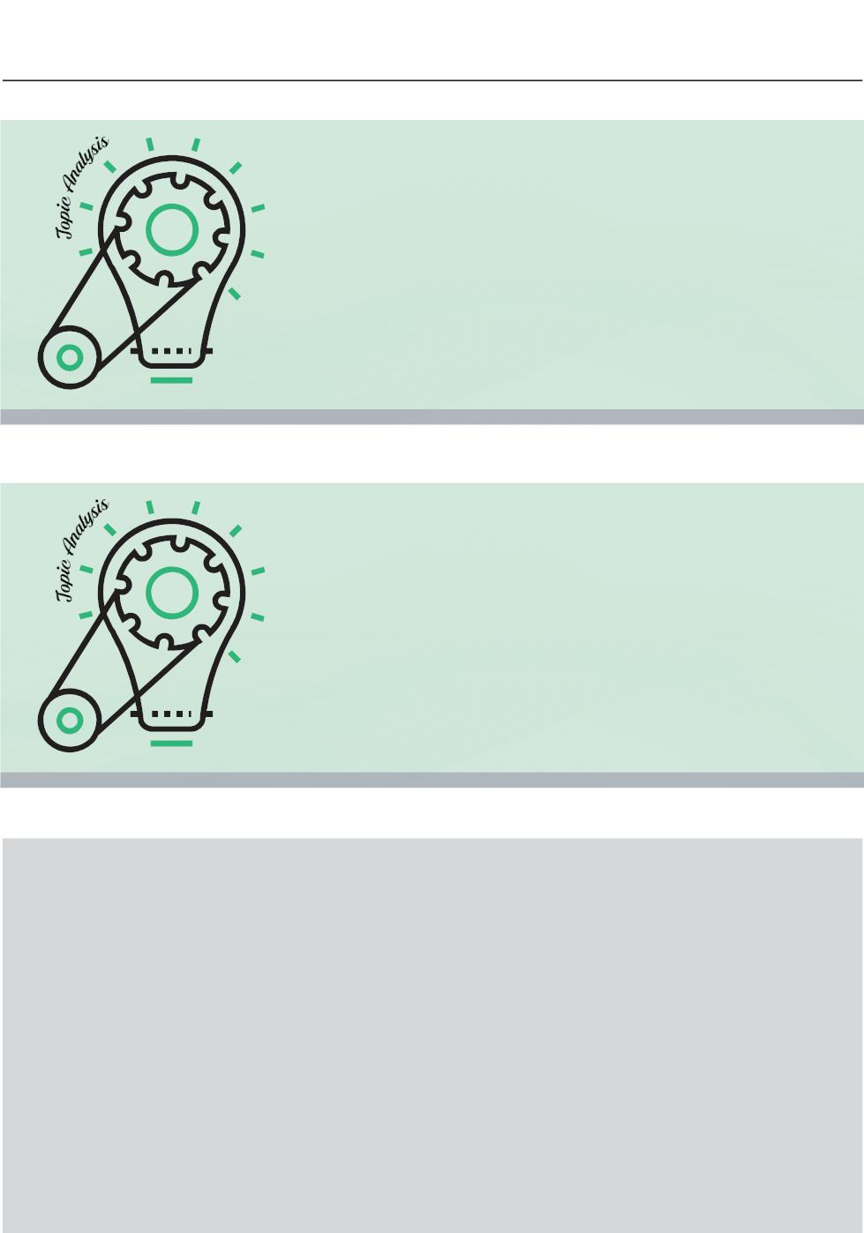
|
Facilitator Guide Clean Code: Software Craftsmanship
What did You Grasp?
1. Which model is also called as the classic life cycle or the
Waterfall model?
A) Iterative Development
B) Linear Sequential Development
C) RAD Model
D) Incremental Development
2. What is the simplest model of software development paradigm?
A) V-model
B) Spiral model
C) Big Bang model
D) Waterfall model
3. In which of the following phases of maintenance, the
software is ported to work in a new environment?
A) Corrective maintenance
B) Perfective maintenance
C) Adaptive maintenance
D) None of the above
4. Which of the following testing is carried out by a primary
group of customers?
A) Alpha-testing
B) Beta-testing
C) Gamma-testing
D) Delta-testing
Facilitator Notes:
Tell the participants that they will be going through a knowledge check question.
Answers:
1. b. Linear Sequential Development
2. d. Waterfall model
3. c. Adaptive maintenance
4. b. Beta-testing
36 |
Copyright © 2019, Xebia Group. All rights reserved. This course is licensed to UPES

Slide 33
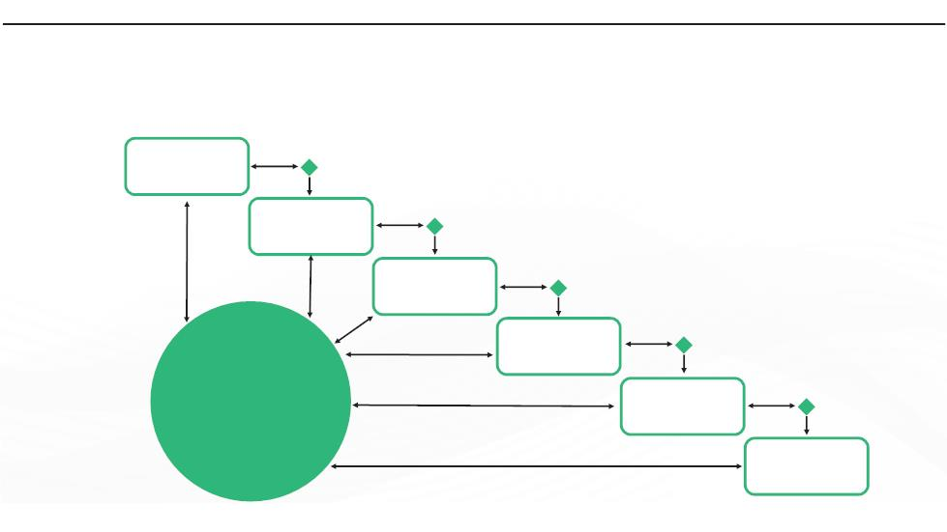
|
Module 1 Agile Practices
1.11 Gated Waterfall Model
The following picture depicts the phases in the gated waterfall model.
Requirements
Architecture
Design
Construction
Change
Control
Test
Deploy
Facilitator Notes:
Explain the participants about the gated waterfall model, which is a modiﬁed version of the
classic waterfall model. Explain the participants about the changes in the gated model,
compared to the classical model.
In the gated waterfall model, the development has to pass through a ‘quality gate’ to move
between phases. The quality gate is based on the review and acceptance of artifacts – for
example a Software Requirements Speciﬁcation (SRS) might be a result of the Requirements
phase, a Software Architecture Design (SAD) is the result of the Architecture phase, and so
on. At the end of each phase, the feedback goes back to any phase by means of a Change
Control process. This change control process is considered to be a change prevention process
in most traditional teams. Though there are quality gates, they do not have any major impact
on the quality, in practice.
The major diﬀerence between the classical and gated waterfall model is the presence of
quality gate between the phases, which provides room for feedback and corrections.
We learnt about the important traditional software development model. We’ll now look at the
issues with traditional development methodologies.
Copyright © 2019, Xebia Group. All rights reserved. This course is licensed to UPES
| 37

Slide 34
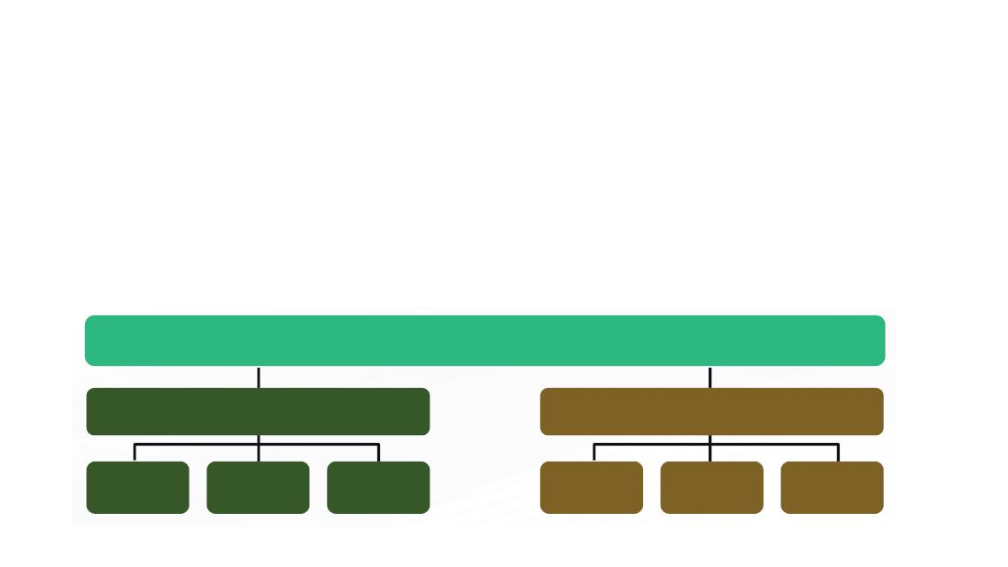
|
Facilitator Guide Clean Code: Software Craftsmanship
1.12 Tradiꢀonal IT Organizaꢀons
Cultural hindrance between development and operations teams in traditional SDLC.
● Development and operations are two sides of an equation holding their own roles and
responsibilities.
● The development team works independently on code. The code then sent to the testing
team for validation.
● Operations team comes in toward the end of the process, handover of the release.
● There is no collaboration between these teams.
CIO
Head of Development
Head of Operation
Facilitator Notes:
Explain how development and operations happen in a traditional SDLC, and how conﬂicts
emerge out of it.
So far we have seen about software and its types, the history of software engineering and the
waterfall model as an example for traditional software development.
Organizations that follow the traditional way of software development work with strict
principles and in these organizations, the development and operations teams function as
two separate entities. Development team tends to be driven by how many new functionalities
can be churned out in a given time, therefore change is its incentive. Operations team on the
other hand, tends to be driven by the stability of the status quo and its incentive is therefore
resisting change.
38 |
Copyright © 2019, Xebia Group. All rights reserved. This course is licensed to UPES

Slide 35
|
Module 1 Agile Practices
There exists a cultural hindrance between development and operations teams in traditional
SDLC. In a traditional setup, the development team works on code which is then sent to the
testing team for validation against requirements. The operation team comes in toward the
end of the process, where the handover of release is given.
Most of the organizations, who have adopted traditional SDLC, face a situation like this on a
daily basis:
● A developer produces some code and tests it in a pre-production environment.
● Operations then pushes the updated code into the production environment.
● Something breaks in the production environment, and the operations team reports a bug
to the developer.
● The developer tests the bug in the pre-production environment and cannot reproduce it.
● The developer sends the bug back to operations, thinking it’s an operational issue.
● The issue then goes back and forth between teams, wasting valuable time and creating
the potential for end-user frustration.
This causes a disconnect and there is hardly any collaboration between the development
and operations teams. This leads to the rise of conﬂicts among the teams, which has a direct
impact on the software being developed and delivered to the customer. More about this will
be explained in the forthcoming section.
1.13 Developers vs IT Operaꢀons Conﬂict
1. Meaning
2. Development Changes
3. Confusions /Lack Of Communication
4. Operations Stability
Copyright © 2019, Xebia Group. All rights reserved. This course is licensed to UPES
| 39

Slide 36
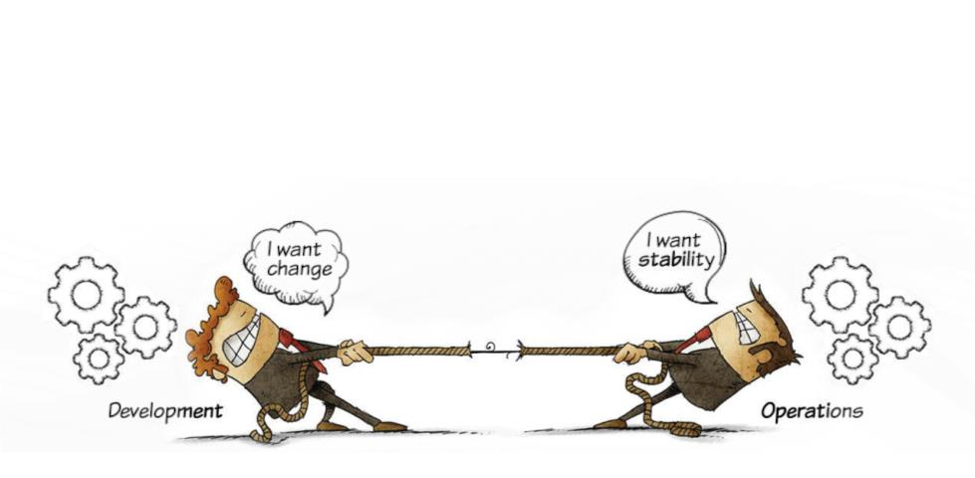

|
Facilitator Guide Clean Code: Software Craftsmanship
Facilitator Notes:
Explain that organizations are far from being a strategic, well-oiled discipline that directly
delivers business value. Many challenges exist that hamper business operations, growth,
and success. There is tension (or wall) between development and operations teams in
software development circles.
Ask the following questions to the participants based on the images depicted on this slide:
● What is the key goal of the development team?
● What is the function of operations team?
● Is the development and the operations teams connected to each other?
Various challenges occur due to contracting goals of the various teams, especially the
development and the operations, involved in the software development and delivery. The job
of the development team is to build software and apply changes to incorporate new features
and fulﬁl the internal as well as the external requirements. On the other hand, the operations
team focuses on stability, reliability, and performance of the systems maintained by the team.
The two competing contradicting goals of the two teams result in a wall of confusion.
The wall of confusion prevents required communication between the development and the
operations teams and results in severe problems in production that causes blast like situations,
such as no methodical handover to the operations team is done leading to ‘half cooked meal’
like situation. Consequently, the operations team faces problems in production that they are
unable to solve and look back to the development team for resolution. This loopback delays
40 |
Copyright © 2019, Xebia Group. All rights reserved. This course is licensed to UPES

Slide 37
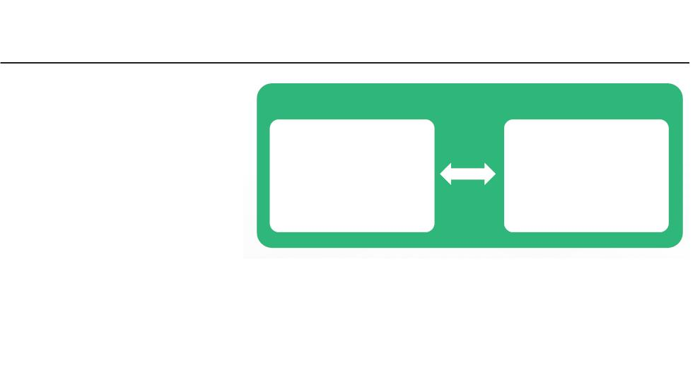
|
Module 1 Agile Practices
problem resolution.
In the absence of required discussions between the development and the operations teams
during earlier phases of development, a lot of useful information is not shared between the
two teams. Such information is crucial for the operations team to get ready for the upcoming
changes to the applications under development. For example, the operations team can
share valuable information from their experience of managing production environment. This
information can help the development team design and develop robust applications. However,
due to lack of communication between the two teams, this information sharing is missed.
A critical part of transition between the development and the operations teams is knowledge
articles. These articles help the operations team solve known problems. In the presence
of the wall of confusion, these elaborate knowledge articles are missing. As a result, the
operations team takes extra time to solve trivial problems.
The wall of confusion is caused due to the conﬂicting motivations and mindset with regard
to the development and operations of the software activity. This disconnect results in conﬂict
and ineﬃciency which is generally a mindset called wall of confusion.
1.14 Problems with the Tradiꢀonal Development and the Operaꢀons
● Organizational silos
Cohesive Team Approach
● Diﬀerent mindsets
● Diﬀerent implementations
● Diﬀerent tools
Development
Operations
Planning
Development
Testing
Infrastructure Mgt
Security & Compliance
Database Admin
Quality Assurance
Network Technician
● Lack of interest in learning
other tools
● Diﬀerent environments
● Loss of work
● Blame game
● Build rollback
Copyright © 2019, Xebia Group. All rights reserved. This course is licensed to UPES
| 41

Slide 38
|
Facilitator Guide Clean Code: Software Craftsmanship
● Disintegrated process
● No feedback loop
Facilitator Notes:
The slide lists some of the problems between the development and the operations teams
due to the traditional way of developing applications.
Some of the problems with the traditional development and the operations teams include:
●
Organizational Silos: The two teams work in isolation that do not allow them to understand
each other’s problems and perspectives. Every individual and every single team, whether it’s
development, operations, quality assurance, or the support team, all come across challenges
on a daily basis. Regardless of who is responsible, the problem needs to be solved. Without
collaboration, this process takes longer and can create further problems that may not be
immediately apparent. Working together and communicating eﬃciently allows you to implement
solutions that will help prevent similar incidents in the future.
●
Diﬀerent Mindsets: The development team always wants to incorporate every new technique/
feature to do their work eﬃciently. On the other hand, changes are not at all acceptable by the
operations team because change results in instability. Therefore, change is the biggest enemy for
the operations team.
●
●
Diﬀerent Implementations:The diﬀerent implementations to perform the same work by the team’s
results in incompatibility and lead to various bugs in the QA and the production environments.
Diﬀerent Tools: The diﬀerent tools used by the two teams lead to various errors and bugs in the
production environment. For example, the development team might deploy to a test environment
using the dependency management tool, while operations team might use a home-grown script
for the process.
●
●
Lack of Interest in Learning Other Tools: Each team considers its tool or style of working to be
the best and does not want to learn a new tool.
Diﬀerent Environments: The diﬀerent environments, such as development, production, and
testing, is one of the biggest causes of various errors and bugs raised by the diﬀerent teams.
●
●
Loss of Work: The various errors and bugs results in loss of valuable eﬀorts.
Blame Game: A lot of diﬀerences between the teams and environments force the teams to pass
on the blame of delayed delivery or build rollback on each other. It’s unnecessary placing blame
and pointing ﬁngers, the key here is to use the available time and resources to solve the issue.
●
Build Rollback: A build is a version of the software that is deployed and rolled out to the customer
after stringent tests. During the build process, source code is converted into a standalone software
42 |
Copyright © 2019, Xebia Group. All rights reserved. This course is licensed to UPES

Slide 39
|
Module 1 Agile Practices
artifact, called build artifacts that can be run on computer systems. A build doesn’t always go right.
Many times teams will be forced to roll back the build due to various reasons, such as incorrect
client requirements, incorrect database (DB) in the QA or production environment, incompatible
tools and others.
●
●
Disintegrated Processes: Development processes do not integrate well with operations
processes.
No Feedback Loop: Lack of a continuous feedback loop in development and operational
processes causes gaps.
To solve the issues that arise due to the wall of confusion and the conﬂicts that exists between
development and operations teams, in traditional IT organizations, and to develop quality
software in a short time, companies have started moving from traditional approaches to
DevOps.
What is the solution?
The wall of confusion between the development and operations teams is one of the major
reasons for the emergence of DevOps. With DevOps, the development and operations
teams work in collaboration to minimize the eﬀort and risk involved in releasing software.
Collaboration can be ensured by the operations team by means of giving constant feedback
to the development team about the code, analyzing the impact considering end users and
troubleshooting any problems together to gain stability of the product. DevOps enables a
cultural change to remove the barrier between development and operations, working together
for common set of objectives. Some of the approaches for solving these issues is:
● Working as cohesive teams
● Having shared objectives
● Coordinating work and sharing information between teams
● Collaboration
● Use of shared tools
DevOps is fundamentally an extension to Agile and Lean principles, as it attempts to instil those
same values and practices into Operations. You will learn in detail about Agile development
in the forthcoming modules.
Copyright © 2019, Xebia Group. All rights reserved. This course is licensed to UPES
| 43

Slide 40

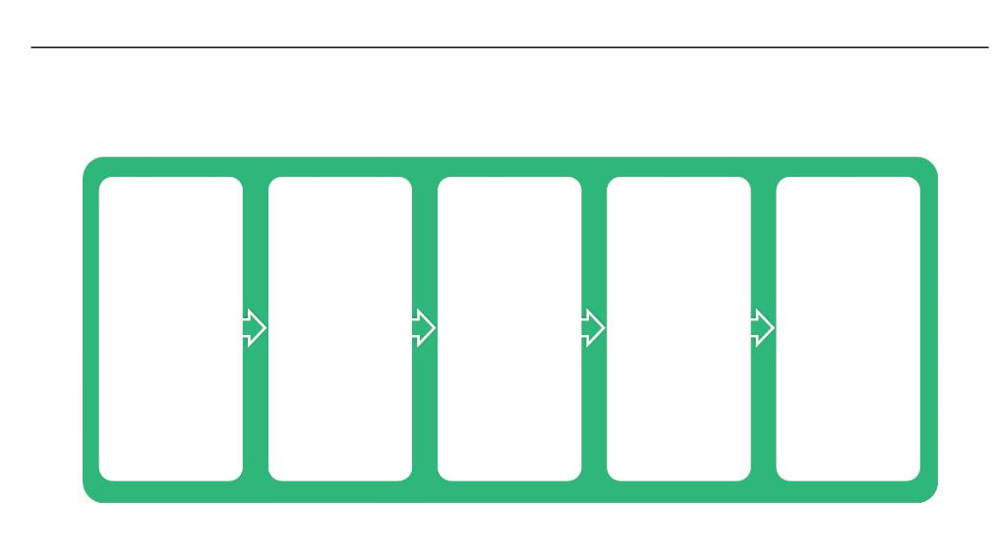
|
Facilitator Guide Clean Code: Software Craftsmanship
What did You Grasp?
1. There is a negative effect on deployment and delivery dates
in case of conflict between the developers and the IT
operations.
A) True
B) False
2. Which of the following is NOT a consequence of wall of
confusion?
A) Lack of communication
B) Errors and bugs due to the use of different tools
C) Application delivery in a fast pace
D) No methodical handover
Facilitator Notes:
Tell the participants that they will be going through a knowledge check question.
Answers:
1. a. True
2. c. Application delivery in a fast pace.
1.15 Birth of Agile
The following is the process illustrates the birth of Agile:
Initial
gathering of
thought
leaders from
the software
industry in
2000 in
Oregon,
Rogue River
Lodge
An alternative
to the
document-
driven,
heavyweight,
traditional
software
The Snowbird
meeting in
Utah in
February,
2001.
Discussions
on developing
‘light’ or
“lightweight’
method of
Emergence of
the “Agile
Software
Development
software
development.
Manifesto’.
development
processes.
44 |
Copyright © 2019, Xebia Group. All rights reserved. This course is licensed to UPES

Slide 41
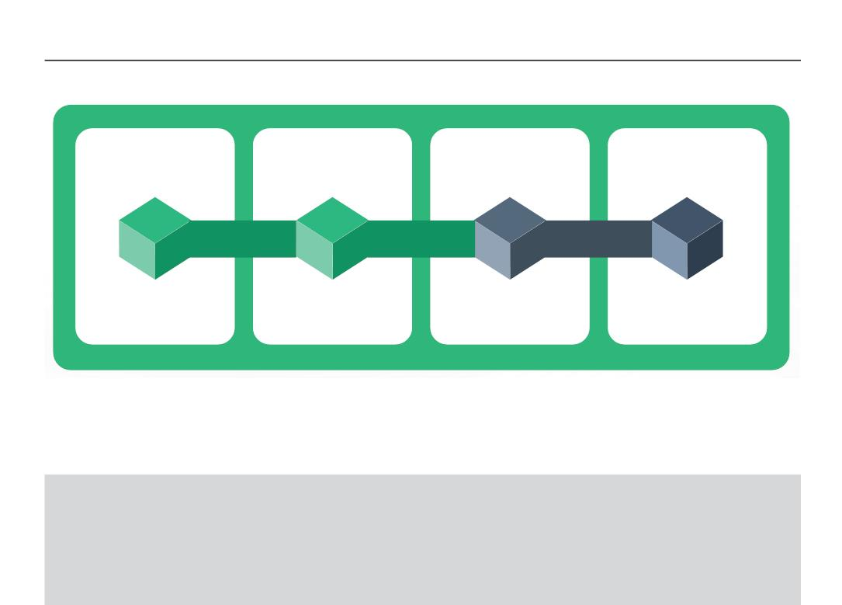
|
Module 1 Agile Practices
1.16 Four Values of the Agile Manifesto
Individual and
Interactions
Working Software
Customer
Collaboration
Responding to
Change
O
V
E
R
Processes and
Tools
Comprehensive
Documentation
Contract
Negotiation
Following a Plan
“That is, while there is value in the items on the right, we value the items on the left more.”
Facilitator Notes:
● Show the participants the values of the Agile Manifesto
● Describe the importance of values
The agile manifesto reads:
“We are uncovering better ways of developing software by doing it and helping others do it.
Through this work we have come to value:
“Individuals and interactions over processes and tools.
Working software over comprehensive documentation.
Customer collaboration over contract negotiation.
Responding to change over following a plan.”
“That is, while there is value in the items on the right, we value the items on the left more.”
Each of these four values is described in the upcoming sections.
Copyright © 2019, Xebia Group. All rights reserved. This course is licensed to UPES
| 45

Slide 42

|
Facilitator Guide Clean Code: Software Craftsmanship
1.16.1 Agile Manifesto
Agile Manifesto Value 1: Individual and team interactions over processes and tools
INDIVIDUALS AND INTERACTIONS
 Communication—the key to the success of a project
 People build Products
 Have the focus on people and the source of energy
 Self-organization of cross-functional teams—to identify scope, negotiate, accept, define, collaborate,
share, and solve problems
 Individuals need to be motivated
 Interactions need to be fostered among team members, customers and other stakeholders
Facilitator Notes:
Inform the participants that the ﬁrst Agile Manifesto value talks about individuals and
interactions.
Prioritizing individuals and interactions over processes and tools is the ﬁrst value of the Agile
manifesto. People drive the development process since they are the ones who respond to
changing business needs and develop processes and tools in response to change.
If a team prioritizes processes, technology or tools, then the individuals in the team become
less responsive and meeting the customer requirements become a diﬃcult task.
Communication between the team members, customers and other stakeholders is critical for
understanding the business requirements and delivering value. If individuals are valued over
processes and tools, the communication becomes ﬂuid and the interactions happen, based
on the change in business requirements. If processes are valued more, the interactions
become scheduled and less adaptive to changes. There is a possibility of the customer’s
requirements losing importance because of the stringent schedules.
46 |
Copyright © 2019, Xebia Group. All rights reserved. This course is licensed to UPES

Slide 43

|
Module 1 Agile Practices
Agile Manifesto Value 2: Working software over comprehensive documentation
WORKING SOFTWARE
 Create and deliver value
 Customer satisfaction is important
 Deliver frequently and consistently; offer business value to the customer
 The primary goal of software development is to create software, not lengthy documents
 Write documentation that adds value
 Deliver what the customer wants; documentation is always supplementary
 Customer-focus is the primary focus
Facilitator Notes:
Tell the participants that you will be covering the second value here, which is working
software.
The second value as per the agile manifesto is a working software over comprehensive
documentation.
Jim Highsmith, one of the authors of the Agile Manifesto and the primary developer of the
‘Adaptive Software Development’ Agile Method, says, “We want to restore a balance. We
embrace modelling, but not in order to ﬁle some diagram in a dusty corporate repository. We
embrace documentation, but not hundreds of pages of never-maintained and rarely-used
tomes. We plan, but recognize the limits of planning in a turbulent environment.”
If we give customers a choice of selecting between comprehensive documentation and
working software, they would prefer the latter. Agile focuses more on building the product to
satisfy the needs of the customer, than to giving them pages and pages of documentation.
Writing pages and pages of documentation for developing the product, consumes an enormous
amount of time, hence longer time periods between documentation and delivery. A lot of
time, money and energy is spent in writing technical and functional speciﬁcations, customer’s
business requirements, user interface speciﬁcations, design documents, documents on
testing and much more. And the best part is that approvals are required for each and every
document written by people, at multiple levels. This is the major cause of the delay in the
development and delivery of the actual product.
Copyright © 2019, Xebia Group. All rights reserved. This course is licensed to UPES
| 47

Slide 44

|
Facilitator Guide Clean Code: Software Craftsmanship
In agreement with Jim’s statement, Agile does not rule out the need for documentation. Agile
emphasizes that the document is streamlined in a way that it gives the exact picture to the
developer of what is exactly needed to build the software, without getting lost in the intricacies.
According to Agile methodologies, the requirements are documented as user stories, so
the developer gets clarity on the business requirements. This eventually becomes a guide
for the developer to start building the exact functionalities. Agile does give importance to
documentation, but a working software is more critical from a customer’s viewpoint than
documentation. Agile also emphasizes that delivering working pieces of the software at
frequent intervals matters the most to the customer.
Agile Manifesto Value 3: Customer collaboration over contract negotiation
CUSTOMER COLLABORATION
 Flexibility and co-operation in terms of customer’s needs
 Work with the customer
 Make sure the intent of the contract is satisfied
 Understand customer’s product vision by close collaboration
 Let the contracting models be flexible
 Maintain relationships
Facilitator Notes:
Tell the participants that you will be talking about customer collaboration next.
Customer collaboration over contract negotiation is the third value described in the agile
manifesto.
Negotiation enables the customer and the product manager to work out the details of product
delivery. There is a room for re-negotiation as well. In traditional software development
processes, customer engagement is more before the start of the development process and
after the product is completely ready. There are two major disadvantages to this. The customer
gives the complete speciﬁcations/requirements in great detail, well before the development
starts. There is a chance for confusions and multiple rounds of discussions happening even
before the actual work starts, which causes the delay in the development. If the product is
48 |
Copyright © 2019, Xebia Group. All rights reserved. This course is licensed to UPES

Slide 45

|
Module 1 Agile Practices
completely ready, and the customer starts changing the requirements, much eﬀort will be
involved in redoing things.
Agile manifesto emphasizes that the customer is engaged in and collaborates throughout the
development process. Demo sessions should happen periodically. This enables feedback
sharing at regular intervals and the product gets developed iteratively. The development team
and the customer can make sure that the requirements are met at each and every point in
time during the development process.
This value suggests the end - user being part of the development process, attending all the
meetings and making sure changes are communicated then and there and ensuring the
smooth delivery of the project.
Agile Manifesto Value 4: Responding to change over following a plan
RESPONDING TO CHANGE
 Change is the reality, the worst enemy of any plan
 Changes in customer’s business needs - direct impact on developer’s plans
 Adaptive planning for accepting change
 Change to be reflected in the product
 Show improvement
Facilitator Notes:
Tell the participants that you will be talking about responding to change which is the next
value of the Agile Manifesto.
Responding to change over following a plan is the fourth value as per the Agile Manifesto.
A change was considered expensive and avoidable by the traditional software development
methodologies. Planning was considered much more important than responding to changes.
The intention was to have the detailed and comprehensive plans, where feature sets and
functionalities are pre-deﬁned. Since traditional methods follow a sequential order in the
development and delivery of software, a lot of unnecessary dependencies arise. High priority
is given to each and every step of the development process.
Copyright © 2019, Xebia Group. All rights reserved. This course is licensed to UPES
| 49

Slide 46

|
Facilitator Guide Clean Code: Software Craftsmanship
On the other hand, Agile suggests shorter iterations. This enables change in priorities from
iteration to iteration, according to the customer’s requirements. There is room for the addition
of new features in the next iteration, without having any dependency on the previous iteration.
Agile views change as a means for improvement and believes that a change adds value to
the product.
A process called Method Tailoring describes the Agile approach towards change. An Agile
Information Systems Development Method deﬁnes Method Tailoring as a process or
capability in which human agents determine a system development approach for a speciﬁc
project situation through responsive changes in, and dynamic interplays between contexts,
intentions, and method fragments.
With Agile, the process modiﬁcations that ﬁt the team are allowed.
1.16.2 Twelve Principles of the Agile Manifesto
1
2
3
4
5
6
7
8
9
Our highest priority is to satisfy the customer through an early and continuous delivery of valuable software.
Welcome changing requirements, even late in the development. Agile processes harness change for the customer's competitive advantage.
Deliver working software frequently, from a couple of weeks to a couple of months, with a preference to the shorter timescale.
Business people and developers must work together daily throughout the project.
Build projects around motivated individuals. Give them the environment and support they need, and trust them to get the job done.
The most efficient and effective method of conveying information to and within a development team is a face-to-face conversation.
Working software is the primary measure of progress.
Agile processes promote sustainable development. The sponsors, developers, and users should be able to maintain a constant pace indefinitely.
Continuous attention to technical excellence and good design enhances agility.
10 Simplicity‒the art of maximizing the amount of work not done‒is essential.
11 The best architectures, requirements, and designs emerge from self-organizing teams.
12 At regular intervals, the team reflects on how to become more effective, then tunes and adjusts its behavior accordingly.
Facilitator Notes:
Explain the 12 principles in detail.
50 |
Copyright © 2019, Xebia Group. All rights reserved. This course is licensed to UPES

Slide 47
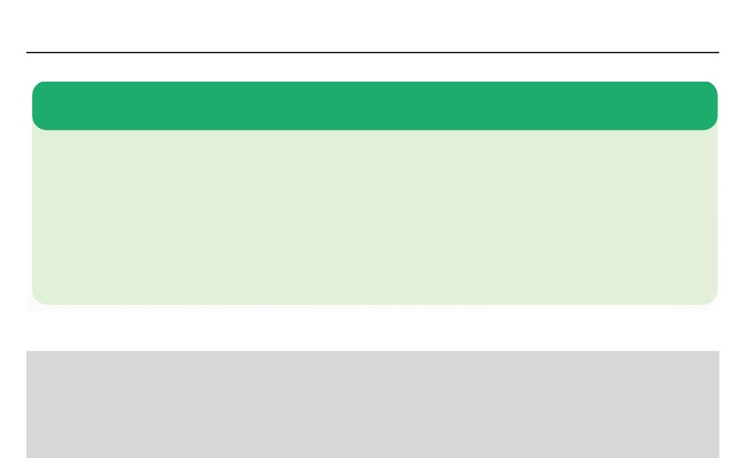
|
Module 1 Agile Practices
1.17 Scrum: An Introducꢀon
Following are the key details of Scrum:
 Scrum is one of the most popular and widely used frameworks to implement Agile in industry projects.
 Scrum has gained so much popularity that it is used synonymously with Agile, but in reality they are
different.
 Scrum is a framework used for incremental product development by deploying one or more cross-
functional, self-organizing teams.
 Using scrum, product development is carried out in small, fixed-length iterations, called sprints.
 Sprints are not longer than 30 days, short sprints are preferred. Every sprint is intended to build a
potentially shippable product increment.
Facilitator Notes:
Give the participants an overview of Scrum. Give them a recap of the evolution of Agile
and walk them through the history of scrum.
Scrum is one of the most popular agile methodologies. Scrum was introduced by Jeﬀ
Sutherland and Ken Schwaber. Ken and Jeﬀ co-presented the Scrum concept at the 1995
OOPSLA (Object-Oriented Programming, Systems, Languages & Applications) conference.
This gave the ﬁrst, formal public deﬁnition of Scrum and it was improvised and redeﬁned by
many industry experts. Scrum is so popular that it is widely used as a synonym for Agile itself,
where in reality these two are diﬀerent. Scrum is one of the ways of implementing Agile. Ken
himself stated once that by early 2009, about 84% of the organizations who were using Agile
in their projects were using Scrum.
Scrum is primarily used for incremental product development. Scrum deploys one or more
self-organizing cross-functional teams. In scrum, the product development is carried out in
small, ﬁxed-length iterations, called sprints. Any sprint should ideally take not more than 30
days, shorter sprints are generally preferred. At the end of every sprint, a releasable, i.e., a
potentially shippable product increment is ready.
Copyright © 2019, Xebia Group. All rights reserved. This course is licensed to UPES
| 51

Slide 48
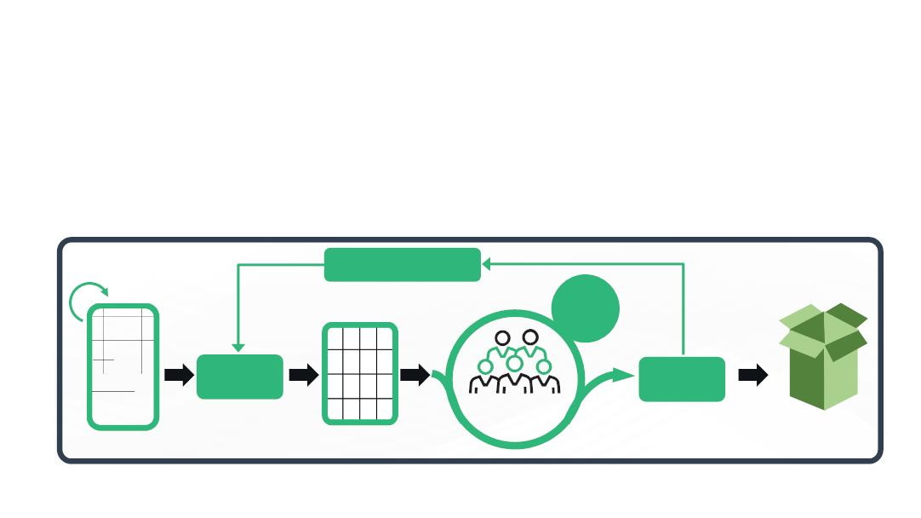
|
Facilitator Guide Clean Code: Software Craftsmanship
According to the developers of Scrum, it is:
● Lightweight
● Simple to understand
● Diﬃcult to master
1.17.1 Why Scrum?
● Scrum is an alternative to the traditional waterfall method.
● Where traditional approaches depends on complete understanding of the requirements
before starting oﬀ, scrum includes all the development activities in each of the sprints.
● Scrum focuses on developing high-value features ﬁrst with the frequent incorporation of
feedback.
The following ﬁgure shows the overall scrum framework.
Sprint Retrospective
Daily
Scrum
Sprint
Planning
Sprint
Review
Sprint Backlog
1 Scrum
Team
Increment
Product Backlog
Source: Scrum.org.
Facilitator Notes:
Explain the participants why Scrum is needed.
Scrum has been extensively used to develop not only software, but also hardware, embedded
software, networks of interacting function, autonomous vehicles, schools, government,
marketing, managing the operation of organizations and most of the stuﬀ that we use in our
daily lives.
52 |
Copyright © 2019, Xebia Group. All rights reserved. This course is licensed to UPES

Slide 49

|
Module 1 Agile Practices
Scrum is a very good alternative to the traditional waterfall model. Traditional approach
requires that the complete requirements are understood before the development commences
and there might not be any room to accommodate changes speciﬁed. Scrum is always
focused on developing high value features ﬁrst, with frequent incorporation of feedback. The
greatest potential beneﬁt of Scrum is for complex work involving knowledge creation and
collaboration, such as new product development. Scrum is usually associated with object-
oriented software development. Its use has also spread to the development of products such
as semiconductors, mortgages, and wheelchairs.
With the increase in technology, market, and environmental complexities and their interactions,
the utility of Scrum in dealing with complexity is proven daily. We can see the eﬃciency of
Scrum in iterative and incremental knowledge transfer. Scrum has now been widely used for
products, services, and the management of the parent organization.
Scrum is eﬀective with a small team of people, who are highly ﬂexible and adaptive. The
same eﬀect can be seen with single or multiple teams. Teams collaborate among themselves
using sophisticated development techniques and target release environments.
1.17.2 Scrum Theory
Scrum is based on empirical process control theory, called empiricism. This ensures that
knowledge originates from experience and decisions are taken based on known things. The
picture illustrates the three pillars of scrum theory.
Transparency
Scrum
Theory
Inspection
Adaptation
Copyright © 2019, Xebia Group. All rights reserved. This course is licensed to UPES
| 53

Slide 50
|
Facilitator Guide Clean Code: Software Craftsmanship
Facilitator Notes:
Explain the participants about the three pillars of scrum theory.
Scrum is based empirical process control theory, also called as empiricism. This ensures that
knowledge originates from experience and decisions are made using known things.
Scrum follows an iterative and incremental approach for optimizing predictability and
controlling risk. The three pillars of the scrum theory are as follows.
Transparency: Transparency ensures that the important aspects of the processes related
to any business are visible to those who are responsible for the outcome. It is important that
these aspects are deﬁned using a common standard. This ensures that all the observers
understand the aspects in the same way. An example for this is that the deﬁnition of ‘Done’ is
common for those who do the work and those who evaluate the results of the work.
Inspection: In order to detect variances that may aﬀect the process, Scrum users should
inspect the Scrum artifacts and progress at frequent intervals. They should also make sure
that inspection doesn’t aﬀect the actual workﬂow. Suitably experienced inspectors should
carry out the inspection process to derive value out of it.
Adaptation: If an inspector identiﬁes that any deviation in any of the process aspects makes
the product unacceptable, adjustments in that process should be made. This adjustment
should be done as soon as the defective process is identiﬁed, so that further deviations can
be avoided.
Four formal events have been speciﬁed by Scrum for inspection and adaptation, which are
described in a later section:
● Sprint Planning
● Daily Scrum
● Sprint Review
● Sprint Retrospective
54 |
Copyright © 2019, Xebia Group. All rights reserved. This course is licensed to UPES

Slide 51
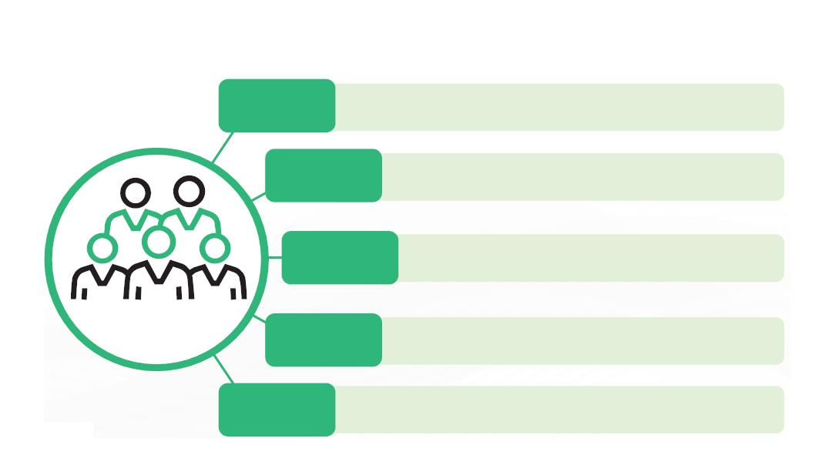

|
Module 1 Agile Practices
1.17.3 Scrum Values
Courage
Scrum Team members have courage to do the right thing and work
on tough problems
Focus
Everyone focuses on the work of the Sprint and the goals of
the Scrum Team
Commitment
Respect
People personally commit to achieving the goals of the
Scrum Team
Scrum Value
Scrum Team members respect each other to be capable
independent people
Openness
The Scrum Team and its stakeholders agree to be open about all the
work and the challenges with performing the work
e: scrum.org
Source: scrum.org
Facilitator Notes:
Explain the participants about the ﬁve values of Scrum. There is a ﬁve-blog series published
on the Scrum website, that will help participants learn more about Scrum values and the
examples. Ask the participants to go through these blogs and help them understand the
values better.
● Part 1 – Focus - https://www.scrum.org/resources/blog/maximize-scrum-scrum-
values-focus-part-1-5
● Part 2 – Openness - https://www.scrum.org/resources/blog/maximize-scrum-scrum-
values-openness-part-2-5
● Part 3 – Courage - https://www.scrum.org/resources/blog/maximize-scrum-scrum-
values-courage-part-3-5
● Part
4
-
https://www.scrum.org/resources/blog/maximize-scrum-scrum-values-
commitment-part-4-5
● Part 5 – Respect - https://www.scrum.org/resources/blog/maximize-scrum-scrum-
values-respect-part-5-5
Copyright © 2019, Xebia Group. All rights reserved. This course is licensed to UPES
| 55

Slide 52
|
Facilitator Guide Clean Code: Software Craftsmanship
Scrum values have been deﬁned to ensure that the three pillars of Scrum, i.e., transparency,
adaptation and inspection, make sense for all the Scrum users. Five values have been deﬁned
by Scrum as follows:
● Commitment: People should be committed to achieving the goals.
● Courage: The Scrum Team members have courage to do the right thing and work on tough
problems.
● Focus: Everyone focuses on the work of the Sprint and the goals of the Scrum Team.
● Openness: The Scrum Team and its stakeholders agree to be open about all the work and
the challenges with performing the work.
● Respect: Scrum Team members respect each other to be capable, independent people.
Scrum is said to be successfully implemented only if people become more proﬁcient in these
ﬁve values.
Go through the following blog series to understand Scrum Values along with examples
● Part 1 – Focus - https://www.scrum.org/resources/blog/maximize-scrum-scrum-values-focus-
part-1-5
● Part 2 – Openness - https://www.scrum.org/resources/blog/maximize-scrum-scrum-
values-openness-part-2-5
● Part 3 – Courage - https://www.scrum.org/resources/blog/maximize-scrum-scrum-values-
courage-part-3-5
● Part 4 - https://www.scrum.org/resources/blog/maximize-scrum-scrum-values-commitment-
part-4-5
● Part 5 – Respect - https://www.scrum.org/resources/blog/maximize-scrum-scrum-values-
respect-part-5-5
56 |
Copyright © 2019, Xebia Group. All rights reserved. This course is licensed to UPES

Slide 53


|
Module 1 Agile Practices
What did You Grasp?
1. What are the iterations in Scrum called?
A) Release
B) Sprint
C) Release cycles
D) Build
2. Which of the following aspects of the Scrum theory ensures that
every stakeholder understands the aspects in the same way?
A) Transparency
B) Inspection
C) Adaptation
D) Commitment
Facilitator Notes:
Tell the participants that they will be going through a knowledge check question.
Answers:
1. b. Sprint
2. a. Transparency
1.18 Scrum Roles
The following picture illustrates the three scrum roles in comparison with the traditional approach.
Product Owner
Determines what needs to be done and sets the priorities to deliver
the highest value
The Holder of Product Value
Traditional approach: Controls the work
Scrum Master
Protecting the Scrum process and preventing distractions
The Servant Leader
Traditional approach: No equivalent
Development Team
Takes on and determines how to deliver chunks of work in frequent
increments
The Self-Organizing Group
Traditional approach: Gets told what to do by the project manager
Source: Scrum Alliance
Copyright © 2019, Xebia Group. All rights reserved. This course is licensed to UPES
| 57

Slide 54

|
Facilitator Guide Clean Code: Software Craftsmanship
Facilitator Notes:
Give the participants an overview of the three scrum roles.
There are three scrum roles. They are as follows:
Scrum Master: The Scrum Master has to make sure that the performance of the Scrum
Team is at their highest level. The Scrum Master also protects the team from both internal
and external distractions.
Product Owner: The key responsibilities of the Product Owner are to maintain the product
backlog, and to make sure that everyone is aware of their priorities and all the stakeholders
are satisﬁed
The Development Team: The Development Teams are structured, self-organizing ones and
manage their work on their own. The teams should be in synergy so that there is eﬃciency
and eﬀectiveness overall.
1.18.1 Scrum Master
The Scrum Master is responsible for promoting and supporting Scrum as deﬁned in the
Scrum Guide.
It is the responsibility of the Scrum Master to support the product owner, development team
and the organization.
The following are the qualities of a Scrum Master, who has a leadership role:
 Works with organizations in implementing Scrum
 Makes sure that Scrum is understood and implemented
 Makes the environment workable, that also ensures team self-organization
 Guards the team from external interference and distractions and ensures harmony
 Helps to encourage improved engineering practices
 Doesn’t manage the team
 Helps overcome hurdles
58 |
Copyright © 2019, Xebia Group. All rights reserved. This course is licensed to UPES

Slide 55
|
Module 1 Agile Practices
Facilitator Notes:
Explain the participants about the roles and responsibilities of a Scrum Master.
The Scrum Master is responsible for promoting and supporting Scrum as deﬁned in the
Scrum Guide. This is achieved by Scrum Masters by helping the Scrum teams understand
Scrum theory, practices, rules, and values.
The Scrum Master leads and supports the Scrum Team. The Scrum Master also helps
the people outside the Scrum Team how they can better interact with the team to produce
maximum value.
Scrum Master’s Service to the Product Owner
The Scrum Master oﬀers service to the Product Owner in the following ways. These include,
but not limited to:
● Makes sure that all the members of the Scrum Team understand well the goals, scope,
and product domain
● Techniques to be implemented for an eﬀective product backlog management
● Helping the Scrum Team understand about Product Backlog Items (PBIs)
● Helps the Product Owner do the product planning
● Makes sure that the Product Owner arranges the Product Backlog in a way that maximizes
value
● Understanding and practicing agility
● Helps the Product Owner by facilitating Scrum events as per the requirements
Scrum Master’s Service to the Development Team
The Scrum Master oﬀers the following services to the Development Team, including, but not
limited to:
● Enables the Development Team to self-organize and teaches them cross-functionality
Copyright © 2019, Xebia Group. All rights reserved. This course is licensed to UPES
| 59

Slide 56

|
Facilitator Guide Clean Code: Software Craftsmanship
● Supporting the Development Team in creating products that create true value
● Helps the Development Team overcome hurdles
● Facilitation of Scrum events
● Oﬀering coaching to the Development Team from organizations that have not adopted
Scrum, to understand the Scrum practices
Scrum Master’s Service to the Organization
The Scrum Master serves the organization in ways, that include the following:
● Helping the organizations understand and adopt Scrum
● Planning and implementation of Scrum within an organization
● Helping employees and stakeholders understand and enact Scrum and empirical product
development
● Helping the Scrum Team in increasing productivity
● Collaborating with other Scrum Masters to increase the eﬀectiveness of the application of
Scrum in the organization
1.18.2 Product Owner
Product Owner holds the complete responsibility of the product and is called Product Value
Maximizer. Product owners understand the business and market requirements and plan the
work to be done by the development team.
The responsibilities and qualities of a product owner include:
 Building and managing the product backlog
 Works closely with the organization and the Team to make sure everyone understands the work items
in the product backlog
 Product Owner takes the sole responsibility of maximizing the return on investment (ROI) of the
development effort
 Defines and constantly re-prioritizes the product backlog, makes adjustments to long-term expectations
such as release plans
 Decides the set of requirements that the development team has to work on
 Remains accountable for the work done by the development team on product backlog
 Decides when to ship the product, by also taking into account frequent delivery
60 |
Copyright © 2019, Xebia Group. All rights reserved. This course is licensed to UPES

Slide 57

|
Module 1 Agile Practices
Facilitator Notes:
Explain the participants the roles and responsibilities of a Product Owner.
The Product Owner is responsible for maximizing the value of the product resulting from work
of the Development Team, hence is called Product Value Maximizer. This process may vary
widely across organizations, Scrum Teams, and individuals. It is important to understand
that Product Owners are not project managers who manage the status of the program. Their
focus lies in ensuring that the Development Team delivers value to the business.
The Product Owner is the single responsible person for managing the Product Backlog.
Product Backlog management includes:
● Identifying and expressing Product Backlog items
● Prioritizing the Product Backlog items to best achieve goals and missions
● Value optimization of the work done by the development team
● Ensuring the visibility, transparency, and clarity on the tasks to be performed by the Scrum
Team
● Making sure that the Development Team understands the PBIs and the priority
Product Owner is the authority who can change the priorities of items in the Product Backlog.
It is the responsibility of the team to respect the decisions taken by the Product Owner.
1.18.3 Scrum Development Team
Characteristics of a development team are as follows:
 Collaborative, cross-functional, i.e., people of varied roles, with varied skills, who carry out different
functionalities
 The Development Team has the capabilities to self-organize/self-manage, with roles assigned
internally
 Along with the Product Owner, the team plans sprints, one at a time
 Development Team holds the autonomous right to plan the increment
 Initial few sprints require the team to sit together and work
 Scrum is against moving people across or splitting them between teams
 Ideal number per team is 6 +/- 3 members
Copyright © 2019, Xebia Group. All rights reserved. This course is licensed to UPES
| 61

Slide 58
|
Facilitator Guide Clean Code: Software Craftsmanship
Facilitator Notes:
Explain the participants about the development team and its characteristics, roles and
responsibilities.
The responsibility of the Development Team is to deliver releasable (tested) Increment of
‘Done’ product at the end of each Sprint. This increment is required during the Sprint Review.
Members of the Development Team solely creates the increment.
The characteristics of the Development Team are as follows:
● As stated above Development Teams are self-organizing. Product Backlog is turned into
potentially releasable Increments at their own discretion, and even the Scrum Master
doesn’t have any say on this.
● Teams are cross-functional, in the sense that a single team has all the skills necessary to
create a product increment.
● There is no speciﬁc job title for the members in a Development Team, irrespective of their
responsibilities.
● According to Scrum, there is no sub-team in a Development Team, irrespective of the
tasks they perform, like architecture, testing, operations, business analysts, etc.
● Though the team members have specialized skills and focus areas, ultimately the Team
as a whole is accountable for the project.
Size of the Development Team
The ideal size of the Development Team is 6 +/- 3 members, anything more or less will result
in complexities. A Team will less than 3 members will have troubles in interaction, which in
turn result in loss in productivity. There might be a skill deﬁcit in very small teams, which will
make the Team unable to deliver the potentially releasable Increment. Having more than 9
members will cause coordination issues. The Product Owner and Scrum Master roles are not
included in this count unless they are also executing the work of the Sprint Backlog.
62 |
Copyright © 2019, Xebia Group. All rights reserved. This course is licensed to UPES

Slide 59

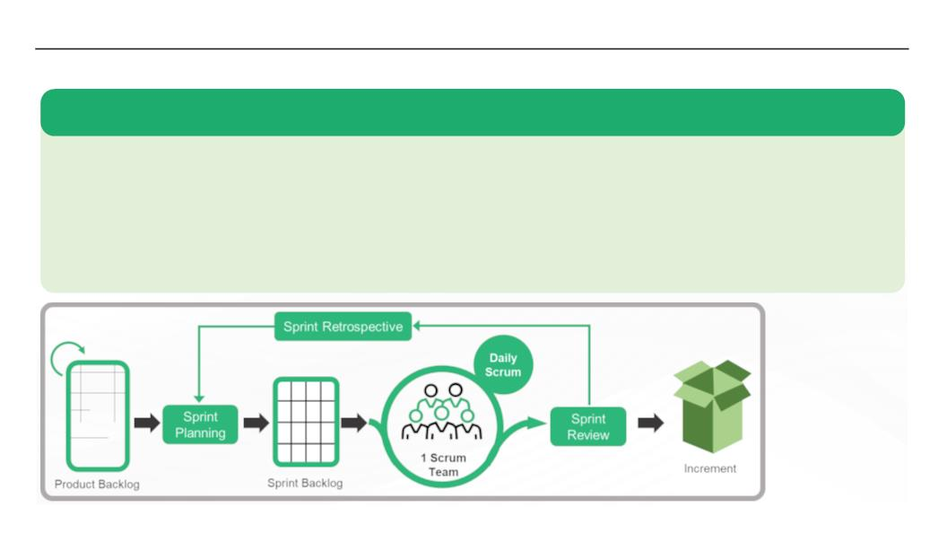
|
Module 1 Agile Practices
What did You Grasp?
1. Who is responsible for protecting the team from internal and
external distractions?
A) Product Owner
B) Scrum Master
C) The team itself
D) None of the above
2. Who builds the product backlog?
A) Product Owner
B) Scrum Master
C) The Development Team
D) Individual team member
Facilitator Notes:
Tell the participants that they will be going through a knowledge check question.
Answers:
1. b. Scrum Master
2. a. Product Owner
1.19 Scrum Sprints
Following are the key details of Scrum sprints:
 A sprint is a short, time-boxed period, during which a scrum team works and completes a certain amount of work.
 With scrum, any product is built in a series of sprints, one iteration of the product in each sprint.
 Sprints are used to break down big, complex projects into bite-sized pieces.
 Sprint is the heart of Scrum, during which a useable and potentially releasable product Increment is created.
 Sprints can be typically be of one week to one month in length and happen one right after the other to keep projects
moving. Shorter Sprints are generally preferred.
Copyright © 2019, Xebia Group. All rights reserved. This course is licensed to UPES
| 63

Slide 60
|
Facilitator Guide Clean Code: Software Craftsmanship
Facilitator Notes:
Explain the participants about the sprints. Sprints are the important component of Scrum.
Sprint is the heart of Scrum, which is a time-box of one month or less. At the end of each
Sprint, “Done”, i.e., a useable, and potentially releasable product Increment is created. The
duration of Sprints are consistent throughout a development. A new Sprint starts immediately
after the previous Sprint is complete.
What happens during a Sprint?
● Changes that may cause any danger to the Sprint Goal are not accommodated
● There will not be any compromise to quality goals
● With time and more learning, the Product Owner and the Development Team renegotiate
and clarify the scope
● Any Sprint will be considered as a project, because a Sprint produces a useable version
of the product
● Each Sprint has a goal as to what has to be built, a design and ﬂexible plan that will guide,
building it, the work, and the resultant product increment
Sprints are limited to one calendar month. Longer sprints may result in change in the deﬁnition
of what is being built may change, with complexities and increased risk. Inspection and
adaptation of the progress towards a Sprint Goal is done at least every calendar month.
Sprint Cancellation
Product Owner has the authority cancel the sprint before the time-box is over. Product Owner
can also cancel a Sprint based on suggestions from stakeholders, Development Team or the
Scrum Master.
A Sprint would normally be cancelled when the goal becomes outdated. This might be because
of business decisions or because of change in technology or market conditions. Because,
Sprints are of short duration, cancellation might not make sense. Any completed and ‘Done’
PBIs are reviewed at Sprint cancellation. After the review, incomplete PBIs are re-estimated
64 |
Copyright © 2019, Xebia Group. All rights reserved. This course is licensed to UPES

Slide 61
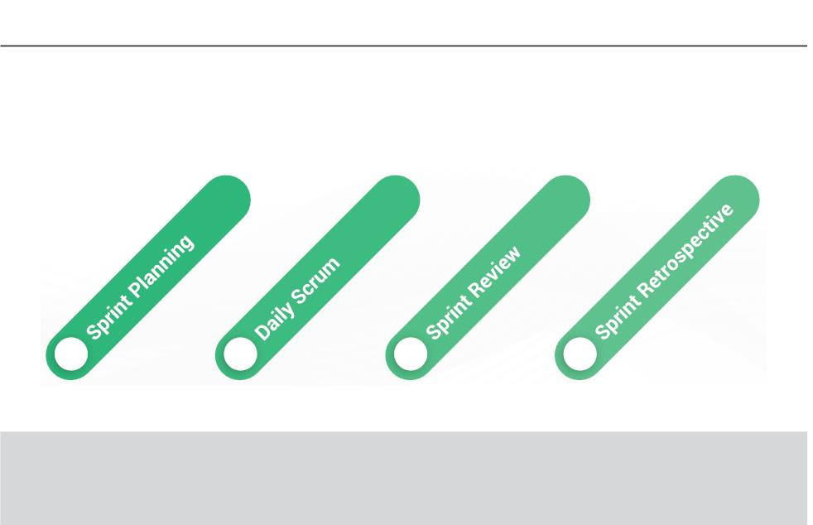
|
Module 1 Agile Practices
and put back into the Product Backlog.
Sprint cancellations generally consume more resources, since the Sprint Planning has to
start from scratch. Cancellations will visibly create an impact on the Scrum Team and these
are very uncommon.
1.20 Scrum Ceremonies or Events
Events are described in Scrum for creating regularity and to reduce the need for meetings
that are not described in Scrum. The picture illustrates the four major Scrum events:
1
2
3
4
Facilitator Notes:
Give the participants an overview of Scrum events, which are also called Scrum ceremonies.
Sprints contain and consist of four major events:
● Sprint Planning
● Daily Scrum
● Sprint Review
● Sprint Retrospective
We’ll see each of these in detail in the upcoming slides.
Copyright © 2019, Xebia Group. All rights reserved. This course is licensed to UPES
| 65

Slide 62

|
Facilitator Guide Clean Code: Software Craftsmanship
1.20.1 Sprint Planning
Following are the key details of Sprint planning:
 At the beginning of each Sprint, the Product Owner and team hold a Sprint Planning Meeting to
negotiate which Product Backlog Items (PBIs) will be converted to a working product during the Sprint.
 Scrum Master ensures that planning happens and the team understands the responsibilities.
 The Product Owner orders the product backlog based on business and technical requirements.
 The Development Team finalizes the amount of work that can be accomplished at the end of a Sprint.
 During the Sprint Planning Meeting, the team decides the ways of accomplishing the work.
 The time-box of Sprint Planning for a 30-day Sprint is eight hours, and is reduced proportionally for a
shorter Sprint.
Facilitator Notes:
Explain the participants about Sprint planning meeting.
During Sprint Planning, the work to be done during a Sprint is planned and ﬁnalized. The Sprint
Goal is also ﬁnalized during the sprint planning meeting. This plan is devised collaboratively
by the Scrum Team. For a one-month Sprint, the Sprint Planning is time-boxed for 8 hours,
this will reduce proportionally for shorter Sprints.
It is the responsibility of the Scrum Master to ensure that Sprint Planning happens and the team
understands its purpose. Scrum Master also ensures that Sprint Planning happens within the
speciﬁed time limit.
Sprint Planning answers two major questions:
● What can be delivered in the Increment resulting from the upcoming Sprint?
● How will the work needed to deliver the Increment be achieved?
Sprint Goal
The Sprint Goal is deﬁned as the objective set for the Sprint that can be met through the
implementation of the Product Backlog. With Sprint Goal, the Development Team Understands
the purpose of building the Increment. The Goal also gives the Team the ﬂexibility with respect
to the functionality to be implemented within the Sprint. The Sprint Goal also determines the
PBIs to be considered for that Sprint and they deliver one coherent function.
66 |
Copyright © 2019, Xebia Group. All rights reserved. This course is licensed to UPES

Slide 63

|
Module 1 Agile Practices
The Development Team always works towards achieving the Sprint Goal. Suitable functionality
and technology are implemented by the Team to achieve the Sprint Goal. In case the Team
ﬁnds that the work is not going in the right direction, they collaborate with the Product Owner
and negotiate the scope of the Product Backlog within the Sprint.
1.20.2 Daily Scrum
Following are the key details of daily Scrum:
 The Daily Scrum is a 15-minute time-boxed event for the Development Team, held every day of the
Sprint.
 During the Daily Scrum, the development team plans the work for the next 24 hours. The team shares
the work done on the previous day, what will be done that day and what are the roadblocks.
 The Daily Scrum is held at the same time and place to avoid the complexities and this also ensures
that team collaboration and performance is optimized.
 The meeting is structured by the development team and it is the internal meeting of the development
team.
 The Development Team or team members often meet immediately after the Daily Scrum for detailed
discussions, or to adapt, or re-plan, the rest of the Sprint’s work.
 The Scrum Master ensures that the Development Team conducts the meeting, but the Development
Team is responsible for conducting the Daily Scrum.
Facilitator Notes:
Explain the participants about Daily Scrum.
The Daily Scrum is conducted for the Development Team everyday of the Sprint. It is a
15-minute time-boxed event, and is the key inspect and adapt meeting. During the Daily
Scrum, Development Team plans work for the next 24 hours.
Using the Daily Scrum, the Development Team inspects the progress that has happened
towards the Sprint. Daily Scrum also optimizes the probability that the Team will achieve the
Sprint Goal at the end of a Sprint. The Development Team should plan the ways to achieve
the Sprint Goal and to make sure that the expected Increment is built at the end of the Sprint.
Copyright © 2019, Xebia Group. All rights reserved. This course is licensed to UPES
| 67

Slide 64

|
Facilitator Guide Clean Code: Software Craftsmanship
The Development Team sets the structure of the Daily Scrum, and there is more than one
way of conducting this meeting. Some of the most commonly answered questions during the
Daily Scrum are as follows:
● What was done the previous day that helped the Development Team meet the Sprint
Goal?
● What will be done today to help the Development Team meet the Sprint Goal?
● Is there any roadblock that prevents the individual or the Development Team from meeting
the Sprint Goal?
The Scrum Master has to monitor and make sure that the Development Team keeps the Daily
Scrum within the 15-minute time-box. The Daily Scrum is conducted as an internal meeting
for the Development Team. If other members are present, it is the responsibility of the Scrum
Master that they do not disrupt the ﬂow of the meeting. Daily Scrums are intended to improve
communications, eliminate other meetings, identify impediments to development that have
to be removed, highlight and promote quick decision-making, and improve the knowledge of
the Development Team.
1.20.3 Sprint Review
Following are the key details of Sprint review:
 A Sprint Review is held at the end of each Sprint to inspect the Increment and adapt the Product
Backlog if needed.
 The Product Owner reviews the PBIs selected during the Sprint Planning Meeting and explains the
ones that are considered done.
 The Product Owner and stakeholders convert their feedback to new PBIs and the Product Owner does
the ordering.
 The Sprint Review Meeting is helpful for external stakeholders, including the end users.
 Sprint review is time-boxed to 4 hours for a one-month Sprint and is proportionally reduced for shorter
Sprints.
Facilitator Notes:
Explain the participants about Sprint review and the happenings of a sprint review.
68 |
Copyright © 2019, Xebia Group. All rights reserved. This course is licensed to UPES

Slide 65
|
Module 1 Agile Practices
Sprint Review is the event that takes place at the end of each Sprint. The purpose of this
meeting is to check the Increment and based on the feedback, to adapt the Product backlog,
if it’s necessary. The tasks done during the Sprint will be discussed by the Scrum Team
and the stakeholder. Sprint Review is primarily done for value optimization and this is done
based on the tasks done and the changes made to the Product Backlog during the Sprint.
Compared to the Daily Scrum, this is an informal meeting to demonstrate the Increment, get
feedback in a collaborative fashion.
It is the responsibility of the Scrum Master to ensure that the Sprint Review happens without
fail at the end of every Sprint and it is time-boxed.
According to the oﬃcial Scrum guide, the events that take place during the Sprint Review are
as follows:
● Attendees include the Scrum Team and key stakeholders invited by the Product Owner;
● The Product Owner explains what Product Backlog items have been “Done” and what has
not been “Done”;
● The Development Team discusses what went well during the Sprint, what problems it ran
into, and how those problems were solved;
● The Development Team demonstrates the work that it has “Done” and answers questions
about the Increment;
● The Product Owner discusses the Product Backlog as it stands. He or she projects likely
target and delivery dates based on progress to date (if needed);
● The entire group collaborates on what to do next, so that the Sprint Review provides
valuable input to subsequent Sprint Planning;
● Review of how the marketplace or potential use of the product might have changed what
is the most valuable thing to do next; and,
● Review of the timeline, budget, potential capabilities, and marketplace for the next
anticipated releases of functionality or capability of the product.
Copyright © 2019, Xebia Group. All rights reserved. This course is licensed to UPES
| 69

Slide 66
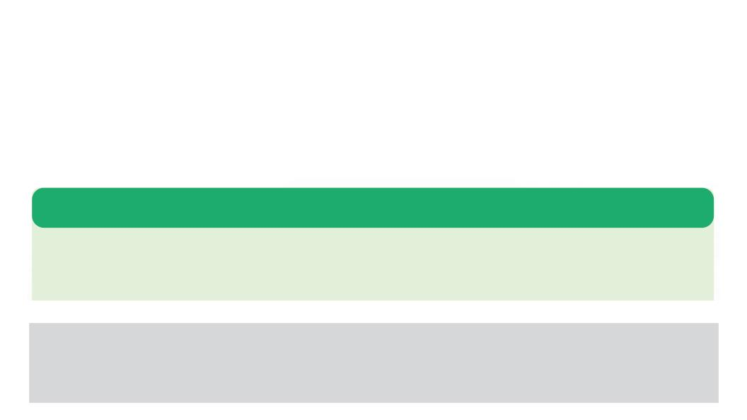
|
Facilitator Guide Clean Code: Software Craftsmanship
At the end of the Sprint Review, the Product Backlog is generally revised such that it deﬁnes
the PBIs for the next Sprint. Adjustments can also be made to accommodate the features
raised in the feedback and meet the requirements.
1.20.4 Sprint Retrospective
● During the Sprint retrospective, the team inspects itself and creates a plan for improvements
that are to be implemented during the next Sprint.
● The Sprint retrospective occurs after the Sprint review and prior to the next Sprint planning.
● This meeting is time-boxed to three hours for a one-month Sprint and is proportionally
reduced for shorter Sprints.
The purpose of the Sprint retrospective is to:
 Inspect as to how the last Sprint went in terms of people, relationships, processes and tools
 Identify the important items that went well and the areas for improvement
 Plan for implementing improvements in the Scrum team
Facilitator Notes:
Explain the participants what happens during Sprint retrospective.
The primary intention of the Sprint retrospective is to do a self-inspection and identifying the
areas of improvement and planning to implement those improvements in the subsequent
Sprints, based on the learning from the current Sprint. This meeting happens after the
Sprint review and is time-boxed to three hours for a typical one-month Sprint and is reduced
proportionally for shorter Sprints.
It is the responsibility of the Scrum Master to ensure that the meeting happens, it is productive
and it solves the intended purpose. Here, the Scrum Master participates as a team member
who is accountable for the Scrum process. Improvements for the Scrum team are suggested
by the Scrum Master, so that they can be applied during the next Sprint. The focus here is
to improve the quality of the product by means of improving the processes or adjusting the
deﬁnition of ‘Done’. Scrum retrospective is not the only time where the team thinks about
improvements, but it is a formal opportunity to focus on inspection and adaptation.
70 |
Copyright © 2019, Xebia Group. All rights reserved. This course is licensed to UPES

Slide 67


|
Module 1 Agile Practices
What did You Grasp?
1. What is the maximum time-box for a sprint?
A) 1 month
B) 1 week
C) 1 day
D) 15 days
2. Which of the following events is considered as an internal
meeting for the development team?
A) Sprint Planning
B) Daily Scrum
C) Backlog Grooming
D) Sprint Review
Facilitator Notes:
Tell the participants that they will be going through a knowledge check question.
Answers:
1. a. 1 month
2. b. Daily Scrum
1.21 Scrum Arꢀfacts
Scrum deﬁnes three artifacts:
Product
Backlog
Scrum
Artifacts
Sprint
Backlog
Increment
Copyright © 2019, Xebia Group. All rights reserved. This course is licensed to UPES
| 71

Slide 68

|
Facilitator Guide Clean Code: Software Craftsmanship
Facilitator Notes:
Give the participants an overview of Scrum artifacts.
Scrum deﬁnes three major artifacts.
● Product Backlog
● Sprint Backlog
● Increment
We’ll look at each of these in detail in the upcoming sections.
1.21.1 Product Backlog
The salient features of the product backlog artifact are as follows:
 Product backlog is a list of the desired functionalities in the order of priority.
 All stakeholders involved have access to the product backlog.
 Items can be added to the product backlog by the development team on discretion of product owner
and Scrum Master.
 Product owner continuously reorders the PBIs.
 It undergoes constant refinement by the Scrum team.
 Items at the top of the product backlog should be smaller than the ones at the bottom.
 During product backlog refinement, more details, estimates and the order to the items in the product
backlog are added.
Facilitator Notes:
Explain the participants about product backlog and its features.
The product backlog is the list of all the items that has to be there in the product, ordered
in terms of priority. Product backlog serves as the one single source of all the requirements
for any change to be made to the product. The product owner decides what goes into the
product backlog, the availability and the order of the items. In general, a product backlog is an
evolving one. During the initial stages only the known and the best understood requirements
72 |
Copyright © 2019, Xebia Group. All rights reserved. This course is licensed to UPES

Slide 69
|
Module 1 Agile Practices
go into it. As the product gets developed and new functionalities are added, the priorities may
change, hence the product backlog also changes. The product backlog, thus, keeps changing
to identify the requirements that make the product appropriate, useful and competitive. As
long as the product exists, the product backlog exists. At any point in time, it gives a picture
of what needs to be done in the product while value is delivered.
The product backlog is a comprehensive list of features, functions, requirements,
enhancements, and ﬁxes needed for the changes to be made to the product in future releases.
The attributes of PBIs are as follows: description, order, estimate, and value. There are also
test descriptions that will prove its completeness when “Done”. As the product is used, and
receives feedback from the market, the product backlog becomes a larger and exhaustive list.
Since the requirements keep changing, the product backlog becomes a living artifact. Some
of the factors that cause changes in a product backlog are: change in business requirements,
market or technology landscape. Most often, multiple Scrum teams work on the same product
and the product backlog lists the upcoming work on the product.
Product Backlog Refinement
Backlog reﬁnement is an exercise during which more details, estimates and order to items
in the product backlog are added. In this process, the product owner and the development
team collaborate on the PBIs and it is an ongoing process. During reﬁnement, the PBIs
are revisited and revised. The Scrum team determines the time and the methods for doing
the reﬁnement. This reﬁnement exercise generally do not consume more than 10% of the
capacity of the development team. The product owner or the team at the product owner’s
discretion, can update the PBIs at any time.
PBIs that have a higher order are more clear and detailed than the ones that have a lower
order, hence the higher order ones can be estimated more precisely than the lower order
ones. PBIs that will go into the upcoming Sprint can be reﬁned, in such a way that they can
be ‘Done’ within the Sprint timebox. PBIs that can be done within the timebox of a Sprint are
considered ‘Ready’ for selection in a Sprint planning. Through the reﬁning activities the PBIs
gain transparency.
The development team owns the responsibility for the estimates, since they are the people
who perform the work. The product owner can help the development team to understand and
select trade-oﬀs during this estimating process.
Copyright © 2019, Xebia Group. All rights reserved. This course is licensed to UPES
| 73

Slide 70

|
Facilitator Guide Clean Code: Software Craftsmanship
1.21.2 Sprint Backlog
Sprint backlog is the set of PBIs selected for the Sprint, along with the plan to realize the
Sprint goal.
 Every Sprint backlog consists of PBIs selected by the team and the product owner for the Sprint
 Sprint Backlog also consists of the plan for delivering the Product Increment and realizing the Sprint
goal
 In general, Sprint Backlog is a forecast done by the Development Team on what will go into the next
Increment and the effort needed to deliver the functionality into a ‘Done’ Increment
 The Development Team has access to the Sprint backlog
 Sprint backlog is the reference document during the daily Scrum meeting
Facilitator Notes:
Explain the participants about sprint backlog and its features.
Sprint backlog consists of items from the product backlog that are selected for the Sprint,
along with the plan for realizing the Sprint goal. It is like a forecast done by the development
team on the functionality to be present in the forthcoming Increment and the eﬀort required
for delivering the ‘Done’ Increment. Sprint backlog showcases all the eﬀort required by the
development team to attain the Sprint goal. There will at least be one high priority process
improvement that was identiﬁed in the previous retrospective. During the course of the Sprint
the development team constantly modiﬁes the Sprint backlog and it evolves during the Sprint,
as the team works and makes progress and the Team learns more about the eﬀort needed
to attain the Sprint goal.
If new functionality is required, the development team adds it as an item to the Sprint backlog.
As the team works on the project, the estimate of the remaining work is updated accordingly.
Sprint progress is generally monitored by tracking the remaining work. If any of the elements
are found unnecessary, they are removed from the Sprint backlog. The authority to change
the Sprint backlog rests with the development team. Sprint backlog is a live picture of the
work that the development team has to do to accomplish the Sprint goal.
1.21.3 Increment
Increment refers to the sum of all the product backlog items completed during a Sprint and
the value of the increments of all the previous Sprints.
74 |
Copyright © 2019, Xebia Group. All rights reserved. This course is licensed to UPES

Slide 71
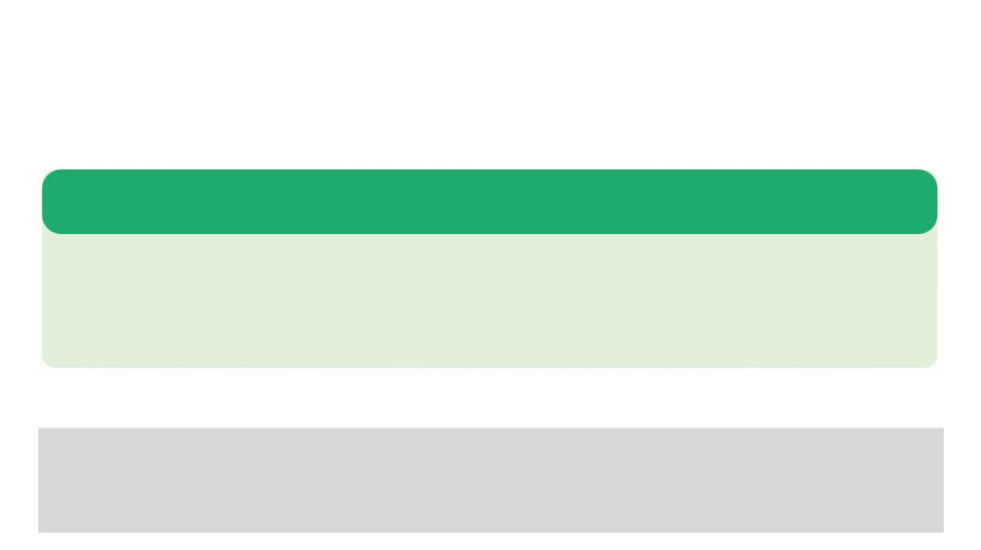

|
Module 1 Agile Practices
The salient features of an increment are as follows:
 An increment consists of the product capabilities completed during the Sprints
 An increment is should be a usable, releasable state by the end of each Sprint
 An increment is released at the discretion of the product owner
 During the Sprint review Meeting an increment is inspected
Facilitator Notes:
Explain the participants about increment and its features.
An increment refers to the sum of all the product backlog items completed during a Sprint and
the value of the increments of all previous Sprints. An increment is said to be ‘Done’, only if it
is in a usable condition and meets the deﬁnition of ‘Done’. A ‘Done’ increment is the outcome
of every Sprint. Each increment takes the product one step further towards the goal. The
authority to release the increments rests with the product owner. The increment should be in
a usable form, regardless of the decision of the product owner to release it or not.
We’ve so far seen about the diﬀerent aspects of Scrum. We’ll now look at the beneﬁts of
Scrum.
What did You Grasp?
1. Who is the authority to decide the items that go into the
product backlog?
A) Scrum Master
B) Product Owner
C) Development Team
D) Customer
2. Which of these artifacts is considered as the reference
document during the daily Scrum?
A) Product Backlog
B) Sprint Backlog
C) Increment
D) Sprint document
Copyright © 2019, Xebia Group. All rights reserved. This course is licensed to UPES
| 75

Slide 72

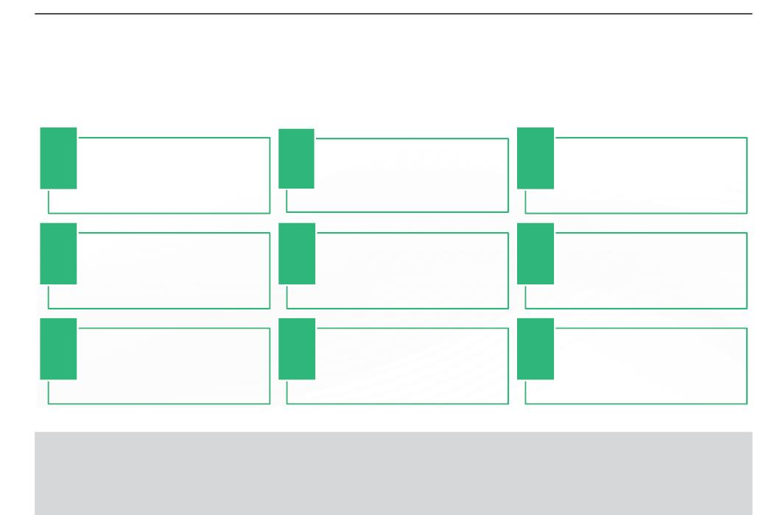
|
Facilitator Guide Clean Code: Software Craftsmanship
Facilitator Notes:
Tell the participants that they will be going through a knowledge check question.
Answers:
1. b. Product Owner
2. b. Sprint Backlog
1.22 Beneꢂts of Scrum
Scrum oﬀers the following beneﬁts over other traditional development methodologies. The
key beneﬁts of Scrum are as follows:
1
4
7
Scrum ensures quality of the product by
means of different practices like defining
and elaborating the requirements,
incorporating feedback, regular and
continuous improvement of the Scrum
team and conducting Sprint retrospectives.
2
5
8
Scrum drastically reduces the time to
market, since it employs an iterative
development and each iteration produces a
usable version of the product in a short
time period.
3
6
9
Higher return on investment (ROI) is
possible with Scrum because it reduces
the time to market.
Scrum teams are committed to delivering
products and services that satisfy the
customers
Scrum promotes collaboration and team
spirit among the stakeholders.
Scrum encourages teams to take
ownership of the projects and products so
they can produce great results.
Scrum uses more relevant metrics to
measure the outcome of any project.
Scrum ensures visibility on progress and
control over the project.
Most importantly Scrum mitigates the risk
of complete project failure, as products are
built over iterations. Any failure can be
identified rectified before proceeding to the
next iteration.
Facilitator Notes:
Enumerate the beneﬁts of Scrum to the participants.
Go through the pointers in the slide and understand the beneﬁts of Scrum. The meticulous
processes that Scrum employs, play a major role in producing the desired product in the
desired quality, hence the beneﬁts.
So far, we learnt about the most important and popular agile methodology Scrum. We’ll now
move on to another popular agile methodology called Extreme Programming (XP).
76 |
Copyright © 2019, Xebia Group. All rights reserved. This course is licensed to UPES

Slide 73

|
Module 1 Agile Practices
1.23 Planning and Esꢀmaꢀon - An Introducꢀon
● Estimation and planning are not just about determining an appropriate schedule or
deadline for any given project.
● Planning for any project should be an iterative and ongoing process to determine what to
build and when to deliver it.
● The factors to be considered while planning are the features to be built, available resources
and the schedule.
● Planning is a very important step in implementing Agile or any other development method.
Planning is important because it helps in the following:
Reducing risk
Reducing uncertainty
Supporting better decision making
Establishing trust
Conveying information
Facilitator Notes:
Give an overview of planning and why it is needed.
Estimation and planning are the crucial steps to implement Agile in any organization. Agile
planning and estimation are not very easy tasks. As customer requirements keep changing,
plan and estimates also should change to accommodate the changes. Estimation and
planning are more than determining schedule or deadlines. Planning should be an ongoing
iterative approach, which is intended towards delivering value. Planning is about determining
what to build and the factors that determine this are, features to build, available resources
and the schedule. A plan that is created at the start of a project may change in the due course
to accommodate the changing requirements, changing priorities and deadlines.
Copyright © 2019, Xebia Group. All rights reserved. This course is licensed to UPES
| 77

Slide 74
|
Facilitator Guide Clean Code: Software Craftsmanship
Planning is essential for the implementation of all Agile projects, because it supports:
●
Reducing risk: Project planning helps the team understand the associated risks. Being aware of
the risks and mitigating them early increases the possibility of project success. Teams may decide
not to start a project if too much of risk is involved. Some risks can be mitigated by attending
to them early. In both these cases planning helps to devise the approach towards reducing or
eliminating risks.
●
Reducing uncertainty: During the course of product development, as new capabilities are
introduced into the product, teams gain new knowledge about the product and the technologies
used. This newly acquired knowledge should go into reﬁning the product vision. One of the most
critical risk factors is that building the wrong product, i.e., the one that the customer does not want.
But in most of the cases this risk is ignored. Agile planning helps in reducing and eliminating the
risk.
●
●
●
Supporting better decision making: Planning and estimating support the organizations in
making better decisions. Any organization has to be aware of the value and cost of the project, to
take a decision whether to take it up or not. Estimates also help the organizations make sure that
they are working on valuable projects. It also helps in allocating resources for a particular project.
Establishing trust: Trust will build between the customer and organization, only if the organization
delivers a high value product with the promised features at frequent intervals. Reliable delivery can
be achieved on the basis of reliable estimates. Estimates help the customer decide on priorities
and take tradeoﬀ decisions. Using estimates, developers can work at a sustainable pace.
Conveying information: Planning communicates and sets the basic set of expectations. In most
of the case plan is distilled down to a single date without the logic that led to those assumptions and
expectations. A good plan clearly communicates what will be accomplished during the accepted
schedule and the assumptions that led to arriving at the schedule.
We’ll cover Agile planning and estimation in this module.
1.23.1 Agile Planning
According to Mike Cohn, the author of Agile Estimating and Planning, “Agile planning balances
the eﬀort and investment in planning with the knowledge that we will revise the plan through
the course of the project.”
● Plan changes only if there is a need that arises based on the learning acquired through
the course of the project.
● Plan changes if the customer requirements change, or change in technology or change
in priorities.
78 |
Copyright © 2019, Xebia Group. All rights reserved. This course is licensed to UPES

Slide 75
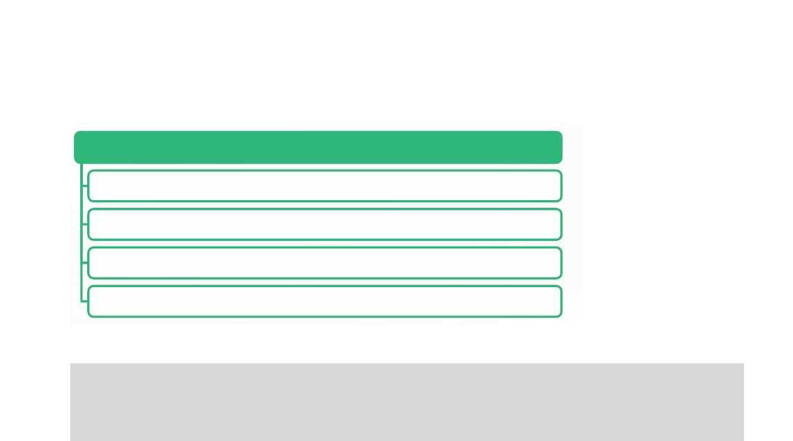
|
Module 1 Agile Practices
The most important aspects of Agile planning include:
It is focused more on the planning than the plan
It encourages change
It results in plans that are easily changed
It’s spread throughout the project
Facilitator Notes:
Introduce Agile planning to the participants.
We have seen that Agile planning is about getting answers to questions like what to be built
and when it will be delivered, by taking into account the cost and resources involved. Planning
also helps managers explore the hidden dependencies on the activities in order to reduce the
idle time and optimizing the delivery period. Agile planning also helps in measuring the speed
and eﬃciency of the Agile team.
Mike Cohn, the author of Agile Estimating and Planning, states that “Agile planning balances
the eﬀort and investment in planning with the knowledge that we will revise the plan through
the course of the project. An Agile plan is one that we are not only willing but anxious to
change.” Plan will change only if there is a customer requirement or change in technology
or change in priorities. Customers may want to include a new feature or remove an existing
feature. Organizations will consider all these factors and their ﬁnancial impact, before making
any alteration to the plan.
An Agile plan is easily changeable and that is why planning becomes more important than
the plan itself. Agile plan is one that is easy to change. Changing an Agile plan doesn’t mean
that the delivery dates will change. The plan can be changed without changing the dates.
Agile planning:
● is focused more on the planning than the plan
● encourages change
● results in plans that are easily changed
Copyright © 2019, Xebia Group. All rights reserved. This course is licensed to UPES
| 79

Slide 76
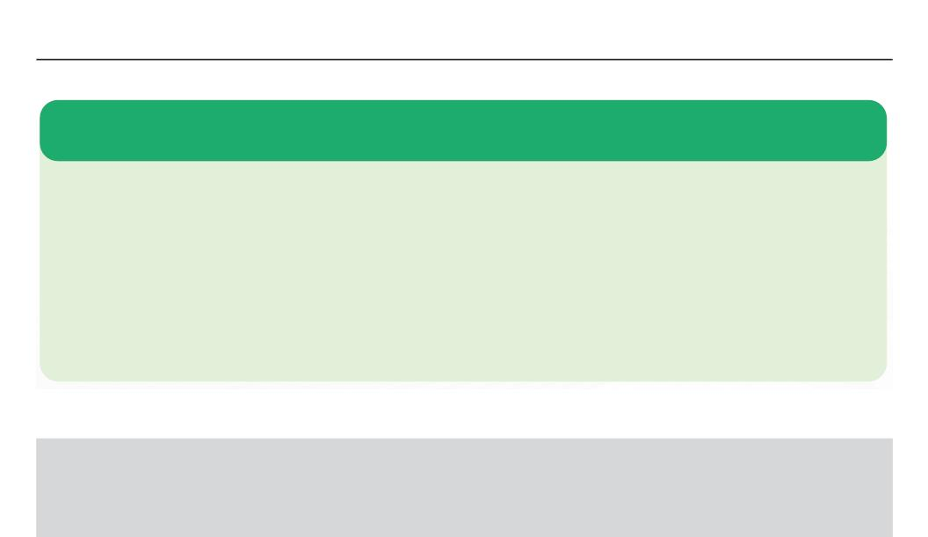
|
Facilitator Guide Clean Code: Software Craftsmanship
● is spread throughout the project
We’ll now look at the need for Agile planning.
1.24 Need for Agile Planning
Agile planning helps in overcoming the deficiencies associated with traditional planning,
which include:
 Focusing more on activities than delivered features
 Ignoring the prioritization
 Not considering the existence of uncertainty
 Considering estimations as commitments
To keep up with the progress of Agile projects and the dynamic environments, the planning has to be Agile
as well.
Agile planning factors in the user requirements and the plan is adapted to accommodate the changes,
which makes it superior to traditional planning.
Facilitator Notes:
Explain the participants the need for Agile planning.
Traditional planning has deﬁciencies that can be overcome by Agile planning. These
deﬁciencies include:
● Focusing more on activities than delivered features
● Ignoring the prioritization
● Not considering the existence of uncertainty
● Considering estimations as commitments
These deﬁciencies make traditional planning unable to keep up with the pace of Agile projects
and they become inappropriate in the dynamicAgile environments. To overcome these issues,
planning also needs to become Agile. In Agile planning, changing customer requirements are
accommodated and the plan is adapted to suit those changes.
80 |
Copyright © 2019, Xebia Group. All rights reserved. This course is licensed to UPES

Slide 77

|
Module 1 Agile Practices
Agile is all about iterative development, and at the start of every iteration, Agile team
incorporates the learning acquired during the preceding iteration and adapts accordingly.
If the team ﬁnds something that will have an impact on the value of the plan, the plan is
adjusted. By over or under estimation of the progress rate, the value of the plan might be
aﬀected. The value of the features to be included in an iteration might also change during
the course of the project. In these cases, the value of the plan can be increased by adding
the most desired features into the initial release and the less important features to a future
release. Thus, Agile plan is accommodating and adaptable.
1.25 The Agile Planning Onion
The given image illustrates the relationship between the diﬀerent planning horizons.
Strategy
Portfolio
Product
Release
Iteration
Day
Credit: Mike Cohn
Facilitator Notes:
Explain the participants about the diﬀerent layers of the Agile planning onion.
An Agile planning is more like a timed race. You’re given a certain amount of time. And you’re
expected to reach as far as possible at that given time.
Copyright © 2019, Xebia Group. All rights reserved. This course is licensed to UPES
| 81

Slide 78
|
Facilitator Guide Clean Code: Software Craftsmanship
An Agile project will be at risk if its planning extends beyond the planner’s horizon and if
there’s no time for the planner to look at the new horizons and make adjustments accordingly.
Most of the Agile teams consider the three innermost levels for planning, i.e., the release, the
iteration and the current day. The relationship between these three and the other horizons are
illustrated in the ﬁgure above.
Release planning: Release planning takes into account the user stories or themes that will be
developed for a new release of a product or system. Release planning is intended to determine
an appropriate answer to the questions of scope, schedule, and resources for a project. Release
planning is usually done at the start of any project, but it doesn’t end there. It is updated throughout
the project, to make sure that it is in lines with the current expectations about the features that will be
included in the release. Updates to the release planning is usually done at the start of every iteration.
Iteration planning: Iteration planning is carried out at the start of each iteration. Based on the
accomplishment in the previous iteration, the product owner identiﬁes the tasks that are of high priority
that the team should address in the upcoming iteration. Iteration is an even closer horizon compared
to a release and thus the components of iteration planning could be smaller. During iteration planning,
teams will list down the tasks that are required to transform a feature request to a usable software,
i.e., working and tested.
Daily planning: Daily planning is carried out by the teams to organize the work and daily eﬀorts.
During the daily planning meeting, teams make, assess and revise their plans. The limit for the daily
planning is the current day, considering the fact that they will meet again the next day. Teams plan on
coordinating the individual activities that help in task completion.
By means of planning across the above three horizons, teams can have their focus on the
visible and important components of the product.
The fourth level, product planning involves a product owner looking further ahead than the
immediate release and planning for the evolution of the released product or system. In portfolio
planning, products are selected according to the vision established through an organization’s
strategic planning.
A slightly updated version of the Agile planning levels and the description of those levels is
given in detail in the upcoming slides.
82 |
Copyright © 2019, Xebia Group. All rights reserved. This course is licensed to UPES

Slide 79

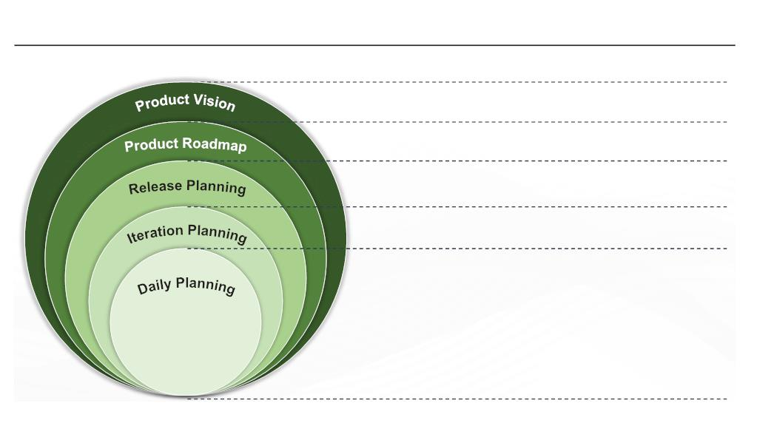
|
Module 1 Agile Practices
What did You Grasp?
1. State True or False.
In Agile planning, the plans cannot be changed easily.
A) True
B) False
2. Which among the following is the most visible horizon in the
Agile planning onion?
A) Day
B) Iteration
C) Release
D) Product
Facilitator Notes:
Tell the participants that they will be going through a knowledge check question.
Answers:
1. b. False
2. a. Day
1.26 Levels of Agile Planning
What, Who, Why, When, Constraints, Assumptions
Releases – Date, Theme/Feature Set, Objective, Development
Approach
Iteration, Team Capacity, Stories, Priority, Size, Estimates,
Definition of Done
Stories – Tasks, Definition of Done Level-of Effort, Commitment
1. What did I do yesterday?
2. What will I do today?
3. What is blocking me?
Copyright © 2019, Xebia Group. All rights reserved. This course is licensed to UPES
| 83

Slide 80
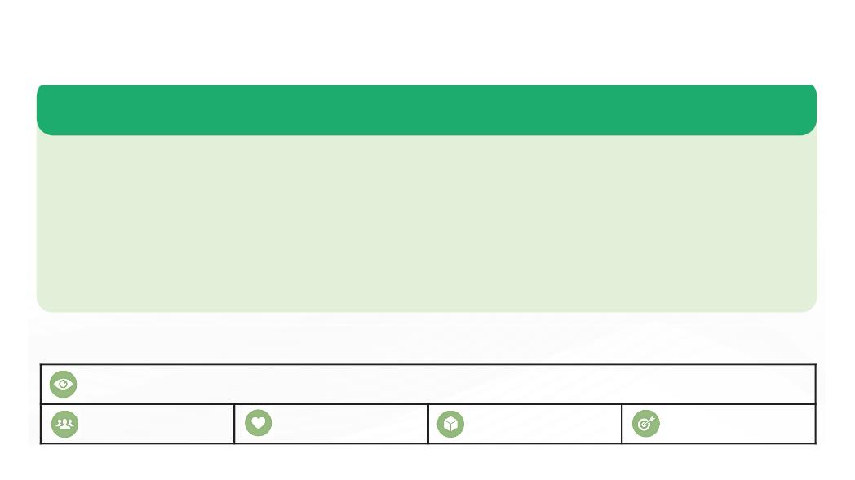
|
Facilitator Guide Clean Code: Software Craftsmanship
Facilitator Notes:
Explain the participants about the diﬀerent levels of Agile planning and the questions
answered and the tasks carried out in each level.
The above illustration shows the ﬁve diﬀerent levels of Agile planning. From the picture you
can also understand the tasks carried out in each level and the questions answered during
those levels. The ﬁve levels of Agile planning are as follows:
● Product vision
● Product roadmap
● Release planning
● Iteration planning
● Daily planning
We’ll look at each of these in detail in the upcoming sections.
1.26.1 Product Vision
Following are the key details of product vision:
 The outermost level of the planning horizon and it concentrates on the future of the product.
 The macro image of the product, i.e., how it will look at the end of the project, is defined at this level.
 Product vision is set primarily by the product owner, with a little support from the project manager.
 Product vision creation step is to ensure that the strategies are aligned properly and the team spends
the time and effort only on creating and delivering the valuable product.
 The vision statement also tells us how the product supports the organization’s strategies. The picture
shows a product vision template.
THE PRODUCT VISION BOARD
VISION
TARGET GROUP
NEEDS
PRODUCT
BUSINESS GOALS
84 |
Copyright © 2019, Xebia Group. All rights reserved. This course is licensed to UPES

Slide 81
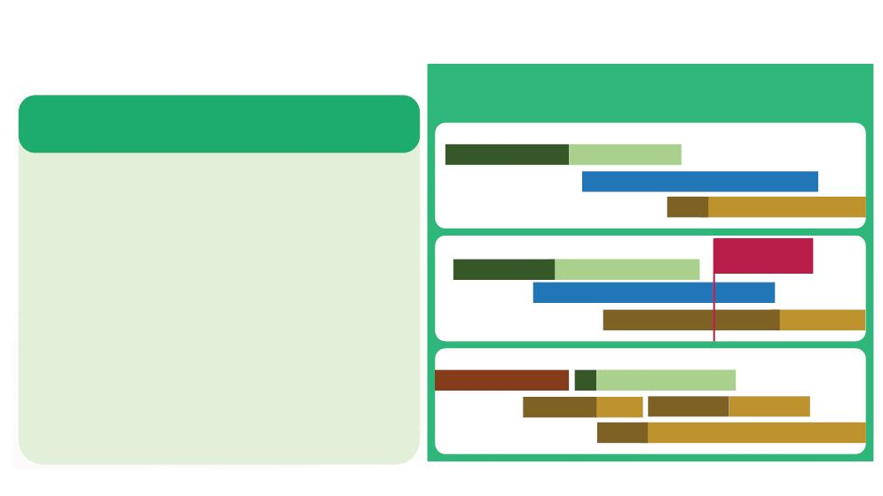
|
Module 1 Agile Practices
Facilitator Notes:
Explain the participants about product vision planning.
Product Vision is the broadest picture of how the product will look at the end of the project.
The product owner establishes the priority and the eﬀort involved in achieving the goal.
The product vision describes the state of the product in six months or more in the future.
Further activities on planning will give more details about the vision and there may even be
diversions from the vision, since the perspective might change in terms of market, product
and the eﬀort required to achieve the vision.
Two common ways of vision exercise are to create an elevator statement or a product box.
Both these exercises are intended to create that statement which describes the future of the
product in terms of product features, target customers, and key diﬀerentiators from other
products.
1.26.2 Product Roadmap
1.26.2 Product Roadmap
2016
Jun
Q3
Jul
Q4
2017
Jan
Following are the key details of product
roadmap:
Product 1
Aug
Sep
Oct
Nov
Dec
 Roadmap is the plan that describes the way that the
> Web Platform
> Web Platform
product is likely to grow.
Distribution
 Agile teams focus on a goal-oriented roadmap, as it
is important for the team to know about the everyday
work.
Product 2
Mobile Release
Oct 27, 2016
 Product roadmap also helps in estimating the budget
for developing and delivering high value product as
per the promised schedule.
> Mobile Platform
Mobile Monitoring Solution
> Marketing Campaign
 Agile environment is prone to changes because of
the changing requirements from the customers,
hence creating a roadmap is often a challenging task.
Product 3
 Product roadmap should focus on goals, benefits,
objectives, acquiring customers and increasing their
engagement. The picture shows a sample product
roadmap.
> Localized CRM
>
Cloud Support
Market Problems Market Opportunities
> Data Logging Module
Facilitator Notes:
Explain the activities carried out during product roadmap planning.
Copyright © 2019, Xebia Group. All rights reserved. This course is licensed to UPES
| 85

Slide 82
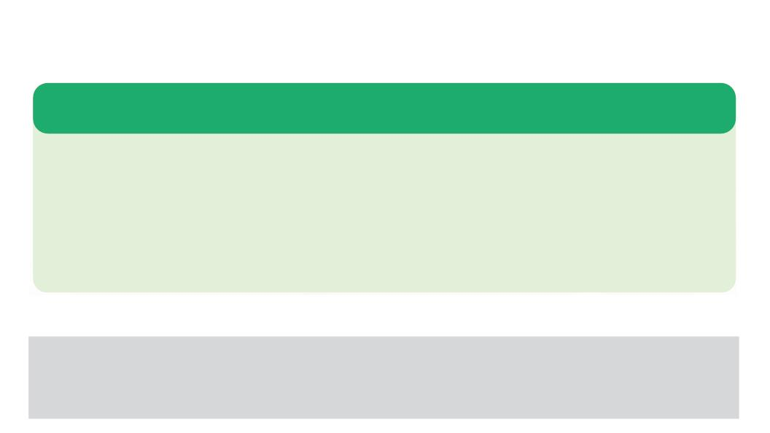
|
Facilitator Guide Clean Code: Software Craftsmanship
Customers demand for changes at more frequent intervals. Time to market in these days is
measured in weeks or months and not in years, which was the case in traditional projects.
This makes the product owner devise a roadmap or path towards the ﬁnal product. A product
roadmap is created and communicated to the fellow team members.
A product roadmap is created primarily by the product owner in a single meeting or a series
of meetings. The roadmap will contain the details of the dates, content, and objectives of the
foreseen releases. The product backlog is also created, which includes the list of desired
features and the priorities.
1.26.3 Release Planning
Following are the key details of release planning:
 Release is a set of increments that are released to the customer at frequent intervals.
 The release plan helps to estimate the amount of work that will be delivered by the team at the
scheduled deadline.
 Release planning is a collaborative effort of the Scrum Master and the product owner, Agile team and
the stakeholders.
 Release planning is focused on goals and benefits, by taking into account, the dependencies and
uncertainties.
Facilitator Notes:
Explain the participants about release planning.
During the release planning, a set of activities is grouped into tasks and assigned to the
teams. A release is the set of product increments that are released to the customer. Some of
the important characteristics of a release are as follows:
● Releases will have the date, theme and a set of features
● In release planning the scope, and not date or quality, is deﬁned, hence a product backlog
is required as the base of the planning event
86 |
Copyright © 2019, Xebia Group. All rights reserved. This course is licensed to UPES

Slide 83
|
Module 1 Agile Practices
● Teams should work in the same rhythm for better management of dependencies
● There are ﬁxed release dates across all team of the program with a typical interval of two
to four months
In general, a release planning session takes place over a day, in case of large teams, it may
take two days. This session is attended by all the team members, including product owner,
delivery team, and stakeholders. Release planning should be as collaborative and interactive
as possible.
A typical agenda for the release planning meeting could be:
● Introduction and goal setting
● Explanation of product vision
● Time-boxes for the releases and iterations
● Capacity calculation by the delivery team
● Agreement of deliverables (when is a feature ‘Done’)
● Moving features from the backlog into the iterations within the release by the individual
teams on the basis of priority
● Dependency determination, by means of analysing the individual planning results
● Estimation of workload per iteration, in accordance with the available capacity
● Review of discovered risks and issues
● Retrospective of the session
Copyright © 2019, Xebia Group. All rights reserved. This course is licensed to UPES
| 87

Slide 84

|
Facilitator Guide Clean Code: Software Craftsmanship
1.26.4 Iteration Planning
Following are the key details of iteration planning:
 Iteration planning is generally a subset of the release plan stories that will be done in the next iteration
or a sprint.
 During iteration planning, the volume of the backlog items that a team can deliver during the next
iteration, are determined.
 The team commits to deliver the features according to their velocity and the schedule.
 Iteration plan is about breaking down the features into multiple development tasks and estimating them.
 Use cases are also created to identify the stories that will be developed and to break them into specific
tasks and acceptance criteria.
Facilitator Notes:
Explain the participants about iteration planning.
Individual iterations within a release are planned at this level. This exercise is done to add
more detail and increasing the accuracy. In this phase, features are broken down into tasks.
Teams commit to the features that will be delivered during the iteration, with a higher degree
of certainty.
An iteration planning has a similar structure to that of a release planning session, the primary
diﬀerence being the planning horizon. Teams work individually to produce their iteration plans,
the synchronization between then help them in detecting and resolving dependencies.
The core of the activities of iteration planning is carried out on a team-by-team basis:
● Actual capacity and the amount of work that can be done by the teams is determined
● Teams break down the features into tasks
● Task sizes are estimated with the task size being half-day to two days
● The deﬁnition of ‘Done’ is taken into consideration, a feature is completely tested and
accepted by the product owner
● The results of the individual teams are inspected in a combined session to determine the
hidden dependencies
88 |
Copyright © 2019, Xebia Group. All rights reserved. This course is licensed to UPES

Slide 85

|
Module 1 Agile Practices
1.26.5 Daily Scrum/Standup
Following are the key details of daily scrum/standup:
 Daily scrum is done to coordinate the work and synchronize the effort.
 Teams make, assess and revise their plans during this meeting.
 Daily scrum is focused on completing the top priority features. This meeting is focused on the
individual’s accomplishments, plan for the day and the issues faced by them and ways to resolve them.
 For the unresolved issues, ‘Parking Lot’ can be used. Anything out of the scope of the daily planning
will be placed in the parking lot and dealt with later.
Facilitator Notes:
Explain the participants about daily planning.
The daily standup meeting, called Daily Scrum is done at the start of every day to set the
context of the current day. This event is time-boxed and the discussion is kept brisk and
relevant. The questions that a development team answer during the Daily Scrum are as
follows:
● What was done yesterday?
● What will be done today?
● Are there any impediments on the way?
Team members explain the lessons learned from the previous day’s session. Issues are
raised and addressed.
Organizations use various processes to manage and coordinate projects and associated tasks
within teams. Stand-up meetings are one such method widely employed by organizations to
track and manage the progress of their internal projects and responsible teams.
Ideally, representatives from teams gather to report the status, plans and changes required to
current projects. All teams follow an identical format of reporting. Diﬀerent team representatives
meet on a regular basis, i.e, once a week to address the questions. Stand-up meetings are
also conducted within each team to answer the same set of questions. The frequency of the
team meetings occurs based on the timelines and project delivery.
Copyright © 2019, Xebia Group. All rights reserved. This course is licensed to UPES
| 89

Slide 86
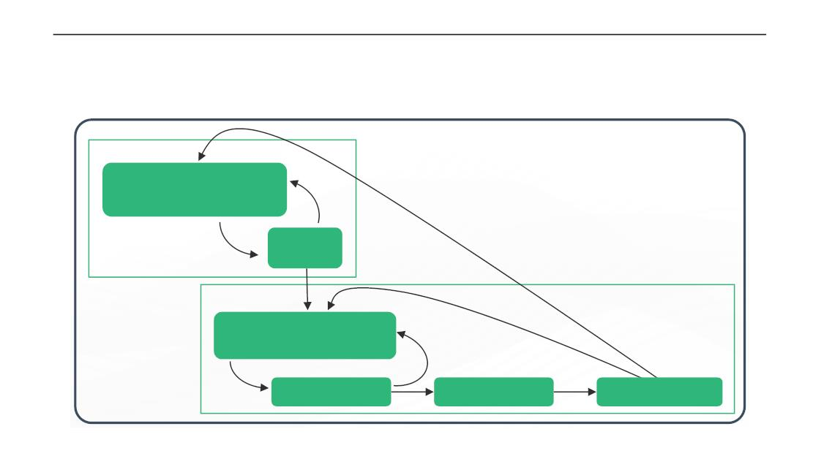
|
Facilitator Guide Clean Code: Software Craftsmanship
1.27 Condiꢀons of Saꢀsfacꢀon
The picture shows how the conditions of satisfaction drive both release and iteration planning.
Release
Conditions of Satisfaction
(user stories, budget,
Feedback
schedule)
Release
planning
Iteration
Conditions of Satisfaction
(user stories + acceptance
tests)
Feedback
Iteration planning
Development
Product increment
Facilitator Notes:
Explain the participants about the conditions of satisfaction.
Mike Cohn deﬁned conditions of satisfaction as “the criteria that will be used to gauge the
success of the project.”
At the commencement of release planning, the team and product owner collaboratively
explore the product owner’s conditions of satisfaction. Product owner’s conditions of
satisfaction include the factors such as scope, schedule, budget, and quality, though quality
is non-negotiable for Agile teams. The product owner and the team will collaboratively look
for meeting all the conditions of satisfaction. In the event of the team not being able to meet
any of the conditions, the conditions of satisfaction must change. Because of this reason,
release planning and exploration of the product owner’s conditions of satisfaction are highly
iterative, which is shown in the ﬁgure above. Similarly, for the iteration planning, the product
owner and the team collaborate to ﬁnd out the ways for meeting the conditions of satisfaction.
90 |
Copyright © 2019, Xebia Group. All rights reserved. This course is licensed to UPES

Slide 87

|
Module 1 Agile Practices
Feedback loops from the new product increment would go back into the conditions of
satisfaction at the start of both the release and iteration.
We’ll now move on to Agile estimation. The ﬁrst concept in Agile estimation that we’ll look at,
is Estimating the size
What did You Grasp?
1. Who is responsible for devising the product roadmap?
A) Developer
B) Product Owner
C) Scrum Master
D) Customer
2. State True or False
Conditions of satisfaction are checked only at the iteration
level.
A) True
B) False
Facilitator Notes:
Tell the participants that they will be going through a knowledge check question.
Answers:
1. b. Product Owner
2. b. False
1.28 Esꢀmaꢀng the Size - Story Points
Estimate is deﬁned as ‘the quantiﬁed evaluation of the eﬀort necessary to carry out a given
development task.’ Estimation is done in terms of size or duration.
Copyright © 2019, Xebia Group. All rights reserved. This course is licensed to UPES
| 91

Slide 88
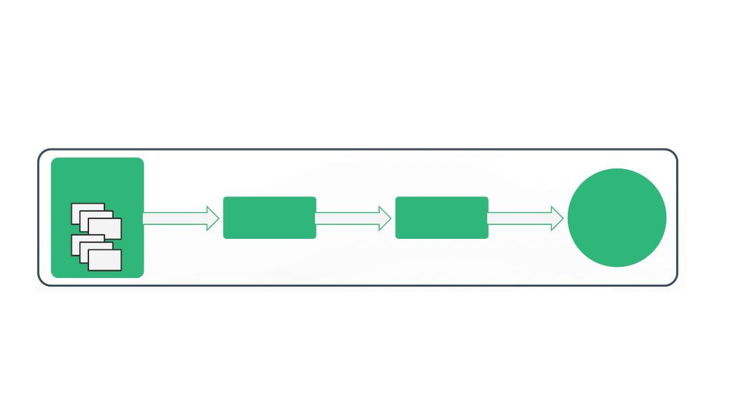
|
Facilitator Guide Clean Code: Software Craftsmanship
● Estimating the size helps in the estimation of duration, which is shown in the ﬁgure given
below.
Desired
Features
Estimate
size
Estimate
duration
Schedule
● Story points are a unit of measure for expressing the overall size of a user story, feature,
or any other piece of work. A point value is assigned to each item while estimating with
story points.
● Story points are relative and not absolute. A story point with a value two should be twice
as much the story with with the value one.
● The number of story points associated with a story represents the overall size of the story.
Facilitator Notes:
Explain the participants about estimating with story points.
Mike Cohn deﬁnes story points are a unit of measure for expressing the overall size of a user
story, feature, or other piece of work. Point values are assigned to each item when estimation
is done with story points. Story point values are relative ones. A story that is assigned a value
two will be as twice as a story with value one. The number of story points associated with a
story represents the overall size of the story. There is no strict formula for deﬁning the story
size. Story size is normally deﬁned on the basis of the amount of eﬀort involved in developing
the feature, the complexity of developing it, the risk inherent in it, and so on.
Typically, there are two ways to get started with story points.
1. Select a story that is expected to be smaller, which is estimated at a value of 1 story point.
2. Select a medium-sized story and assign it a number somewhere in the middle of the
range that is expected to be used.
92 |
Copyright © 2019, Xebia Group. All rights reserved. This course is licensed to UPES

Slide 89

|
Module 1 Agile Practices
Once the ﬁrst story is estimated the remaining stories can be estimated by comparing them
with the ﬁrst story or the ones that have been estimated already. The ﬁrst story will serve as
the base or reference story for the second story. This way relative sizing is done using story
points.
1.29 Velocity
Following are the key details of velocity:
 Velocity is defined as a measure of a team’s rate of progress, which is important to understand the
story points.
 Velocity is by adding the number of story points assigned to each user story that the team completed
during the iteration.
 For example, if a team completes three stories that are valued at three story points each, the velocity of
the team would be nine.
 Based on the velocity of the team during the previous iteration, the estimate for the next iteration can
be estimated.
 If the story point estimates of all the features are summed up, the total size estimate for the project can
be done.
Facilitator Notes:
Explain the participants about velocity and how it helps understand the estimating story
points for a project.
Velocity is deﬁned as the rate of the team’s progress. Velocity is calculated by adding up the
story points assigned to each user story that the team completed during the iteration. For
example, if a team completes three stories that are valued at three story points each, the
velocity of the team would be nine.
We’ll see how we can use velocity to estimate the size. If a team completed ten story points
of work last iteration, we can assume that they will complete ten story points this iteration.
Since story points are estimates of the relative size, this calculation will hold true if the team
completes two ﬁve-point user stories or ﬁve two-point user stories.
The total size of any project is estimated by adding up the story points of all the desired
features that make up a project. If the team’s velocity is known, we can derive the number of
Copyright © 2019, Xebia Group. All rights reserved. This course is licensed to UPES
| 93

Slide 90
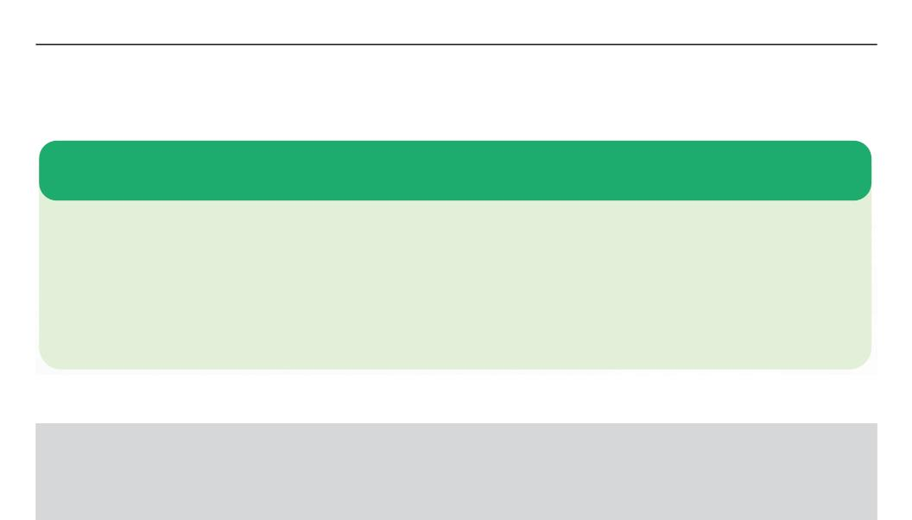
|
Facilitator Guide Clean Code: Software Craftsmanship
iterations by dividing the size by velocity. This duration can then be converted into a schedule
by mapping it onto a calendar. An example of this has been given by Mike Cohn.
“For example, suppose all of the user stories are estimated and the sum of those estimates
is 100 story points. Based on past experience, we know the team’s velocity to be 11 story
points per two-week iteration. Since we can estimate that the project needs 9.1 iterations.
We can either round that up to 10 iterations or ﬁnd one point to remove so that it becomes 9
iterations. Let’s assume we go with a conservative approach and call it 10 iterations. Since
each iteration is two weeks, our estimate of duration is twenty weeks. We can count forward
twenty weeks on the calendar and that becomes our schedule.”
1.30 Esꢀmaꢀng in Ideal Days
In Agile development, user stories or other tasks are estimated in ideal days.
The assumptions behind ideal days estimation are as follows:
 The story being estimated is the only thing that the developer works on
 Everything the developer needs will be on hand when they start
 There will be no interruptions
While estimating the ideal days required to develop, test and accept a user story, it is not necessary to
take into account, the overhead of the environment in which the team works.
If this organizational overhead is ignored, ideal days can be thought of as an estimate similar to story points.
Facilitator Notes:
Explain how the estimate is done as ideal days.
On a software project, user stories or other tasks are estimated in ideal days, based on the
following assumptions:
● The story being estimated is the only thing that the developer works on
● Everything the developer needs will be on hand when they start
● There will be no interruptions
94 |
Copyright © 2019, Xebia Group. All rights reserved. This course is licensed to UPES

Slide 91

|
Module 1 Agile Practices
Estimating in elapsed days instead of ideal days, requires us to consider all of the interruptions
that might occur while working on the particular story. If the estimate is done in ideal days,
only the amount of time the story will take is only considered. In this way, ideal days are an
estimate of size, although less strictly so than story points.
When organizational overhead is ignored, ideal days can be thought of as another estimate
of size, similar to story points. Then, an estimate of size expressed as a number of ideal days
can be converted into an estimate of duration using the velocity in exactly the same way as
with story points.
When estimating in ideal days it is best to associate a single estimate with each user story. If
a user story will take four programmer days, two tester days, and three product owner days,
it is better to sum those and tell the story as a whole will take nine ideal days.
What did You Grasp?
1. What is the velocity of the team that completes five user
stories that have 4 story points each?
A) 10
B) 15
C) 20
D) 30
2. State True or False.
While estimating in ideal days, it is assumed that the
developer works only on the story being estimated.
A) True
B) False
Facilitator Notes:
Tell the participants that they will be going through a knowledge check question.
Answers:
1. c. 20
2. a. True
Copyright © 2019, Xebia Group. All rights reserved. This course is licensed to UPES
| 95

Slide 92
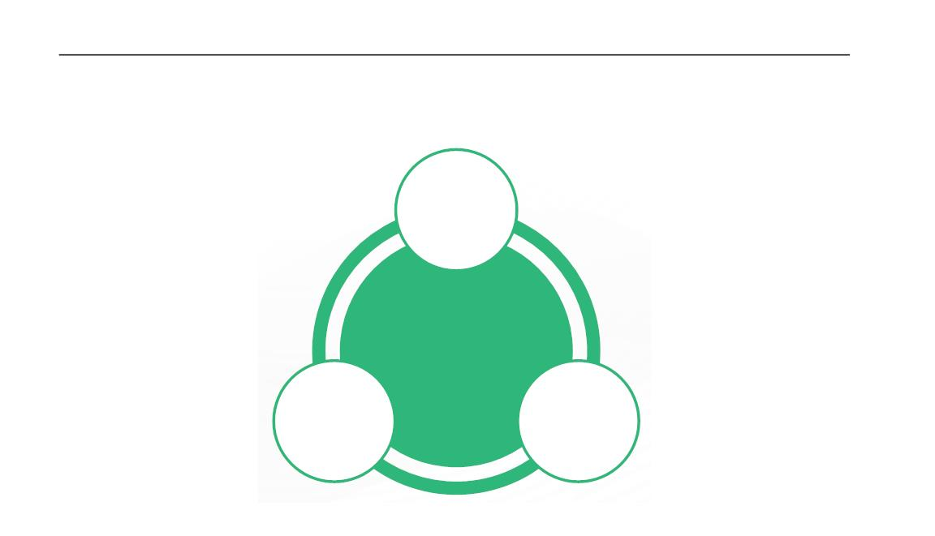
|
Facilitator Guide Clean Code: Software Craftsmanship
1.31 Esꢀmaꢀng Techniques
The three most common techniques for estimating are represented in the ﬁgure below:
Expert
Opinion
Agile
Estimating
Techniques
Disaggregation
Analogy
Facilitator Notes:
Explain the participants about the three techniques for estimating.
Three techniques are commonly used for estimating.
●
Expert Opinion: In this approach, expert opinion on how long some task will take or how big
something will be, is sought out. The expert will provide an estimate based on gut feel or intuition
or past experience. This approach is found to be less useful in Agile projects, since Agile estimating
is done based on user stories or other important functionalities. Developing a functionality requires
varied skill sets and Agile teams are generally cross-functional. It is diﬃcult to ﬁnd experts who
can assess the eﬀort across multiple disciplines. This approach might be suitable for a traditional
project, because each task is performed by one person in traditional projects. One beneﬁt of
getting expert opinion is that it is a less time consuming option.
●
●
Analogy: In this approach, the story being estimated is compared with one or more stories.
Then a relative sizing is applied and estimate is provided. A story twice as big as another story
will be given an estimate twice as large. In this approach, there is no single base or universal
reference. Stories for which estimates are already available are used as benchmarks estimating
other stories. This process is also referred to as triangulation.
Disaggregation: Disaggregation refers to splitting down a user story into smaller, easy to estimate
pieces. Projects with multiple smaller stories are easier to estimate than the ones with the single
96 |
Copyright © 2019, Xebia Group. All rights reserved. This course is licensed to UPES

Slide 93

|
Module 1 Agile Practices
large story. Disaggregation will lead to problems if we go beyond a limit. If we disaggregate too
far, the chances of forgetting tasks also increase.
In the upcoming slides, we’ll look at two commonly used Agile estimating techniques.
1.32 Planning Poker
Following are the key details of the Planning Poker game:
● Planning poker is one of the most popular gross level estimating technique, which
uses Fibonacci sequence (adding previous two numbers to get the next number in the
sequence) to assign point value to a story or a feature.
● Fibonacci sequence has been modiﬁed to get the
following sequence for Agile estimation purposes:
0, 1, 2, 3, 5, 8, 13, 20, 40, 100.
8
● The numbers in the given sequence are represented
in a set of playing cards as shown in the picture.
● Team members play the Planning Poker game and
assign a point value to each item. The process is
explained below in the notes.
● Fibonacci sequence is used as these numbers to represent relative size and this method
also provide the correct level of detail for smaller and better understood projects.
Facilitator Notes:
Explain the participants about the Planning Poker game, which is used for estimating
Agile.
Planning Poker is a game-based Agile estimating technique, based on the Fibonacci
sequence. In the Fibonacci sequence, the previous two numbers are added to get the next
number in the sequence (0, 1, 1, 2, 3, 5, 8, …..). For Agile estimating the sequence has been
modiﬁed to get the following sequence: 0, 1, 2, 3, 5, 8, 13, 20, 40, 100. These numbers are
printed on playing cards. Team members play the Planning Poker game to assign point value
to each story or item. The steps in the game are as follows:
Copyright © 2019, Xebia Group. All rights reserved. This course is licensed to UPES
| 97

Slide 94
|
Facilitator Guide Clean Code: Software Craftsmanship
● Each member in the team gets a deck of cards that read the sequence 0, 1, 2, 3, 5, 8, 13,
20, 40, 100. The team includes programmers, testers, database engineers, analysts, user
interaction designers and so forth. Ideal team size is 10; the number of team members
increases, it is better to split into two teams. Each team will estimate independently.
Product Owner participates, but doesn’t estimate.
● The moderator reads out the story or the item to be estimated. Usually, the product owner
or the analyst will serve the role of the moderator. Product owner answers the questions
of the estimators.
● Each member of the team privately selects a card that represents his/her estimate.
● When all the team members are ready with their estimates, all the cards are revealed at
the same time.
● If all the team members selected the card with the same number, then that number will
be assigned as the point value of the item. If the cards are not the same team then they
discusses the item with the emphasis placed on values.
● The member who selected the lowest and the member who selected the highest value
should explain the logic behind the selection.
● Selection happens until the numbers converge.
● For longer conversations, teams may use a 2-minute timer to timebox the session.
● The process is repeated for each story or each item.
Fibonacci numbers are used, as they represent relative size and the estimate can be done
quickly. This sequence also provides right estimates for smaller and better understood items.
Teams have only less number of choices for assigning the point values and the estimate are
done at a fast pace.
Items with a point value of 20 or higher may be considered as less-understood items. Items
with point estimates between 1-13 can generally be completed in a single iteration of 1 - 4
weeks. One important thing to note here is that the points may have diﬀerent meanings for
diﬀerent teams and team velocity is not the right way to compare productivity across the
teams.
98 |
Copyright © 2019, Xebia Group. All rights reserved. This course is licensed to UPES

Slide 95
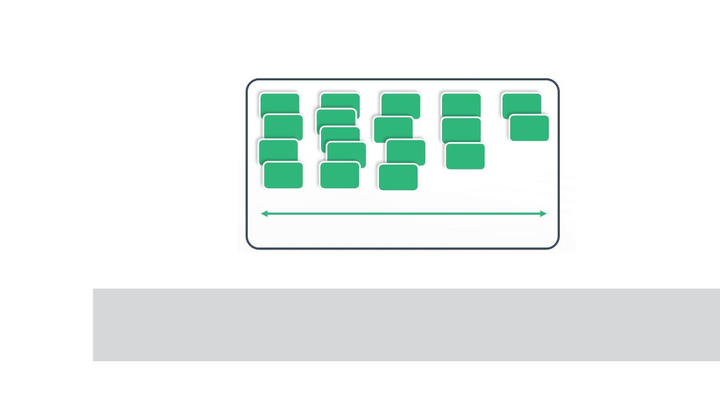
|
Module 1 Agile Practices
1.33 Aﬃnity Grouping
Following are the key details of aﬃnity grouping:
● Aﬃnity grouping is a faster way to Agile estimating, especially when the number of items
to estimate is very large.
● Stories or items that are like-sized are grouped together that results in aﬃnity groups as
shown in the picture.
● The ﬁrst item is read out by the presenter to the team members and placed on the wall.
The second item is then read out and compared with the size of the ﬁrst item. If it is of
smaller size, it goes to the left of the ﬁrst one and if larger, goes to the right.
● All the items are thus read out, assessed and placed on the wall. The team then reviews
the grouping and any inappropriate placement is modiﬁed.
● Once the aﬃnity grouping is complete, point values are then assigned.
Smaller
Large
Facilitator Notes:
Explain the participants about aﬃnity grouping.
Aﬃnity grouping is a faster way to estimate, especially if the number of items to be estimated
is large. Team members analyse and group the items or stories and group similar-sized
items to get a structure like the one shown in the picture. This method is simple and fast. The
method is explained as follows:
● The ﬁrst item is read out by the presenter to the team members and placed on the wall.
Copyright © 2019, Xebia Group. All rights reserved. This course is licensed to UPES
| 99

Slide 96
|
Facilitator Guide Clean Code: Software Craftsmanship
● The second item is then read out and the team discusses and ﬁnds out if it is larger or
smaller than the ﬁrst one. It is then placed on the wall based on the team’s response. If
larger it goes to the right of the ﬁrst one, if smaller it will go to the left.
● The third item is then read out and compared with the ﬁrst two. Based on the size it is
placed on the wall.
● The team then gets the control to ﬁnish the remainder of the items.
● The team can continue the same way of discussing and placing the items on the wall.
Another faster alternative is to have each team member, select one item and place it on
the wall as per their discretion. This is done with all the team members, until all the items
in the project are assessed and placed on the wall.
This way, several items can be estimated in a short period. Once all the items are placed
on the wall, teams then review the grouping. If any team member believes that any item is
placed in the wrong group, it can be moved to the appropriate group after discussion.
Once this grouping is complete, point values are assigned to the items, based on the sequence
discussed in the previous section.
Thus, this section explains the estimation procedure and techniques involved. We’ll now look
into implementation of Agile in industry projects.
1.34 T-Shirt Sizes
The salient features of T-shirt sizes are as follows:
● T-Shirt sizes is a way of estimating relative sizes of features. Five diﬀerent sizes Extra
Small (XS), Small (S), Medium (M), Large (L), Extra Large (XL) are used for estimating
the size of features.
● Using T-shirt sizes is an informal and fast way of assessing the size of backlog items.
● The picture shows how aﬃnity grouping is done using T-shirt sizes.
100 |
Copyright © 2019, Xebia Group. All rights reserved. This course is licensed to UPES

Slide 97
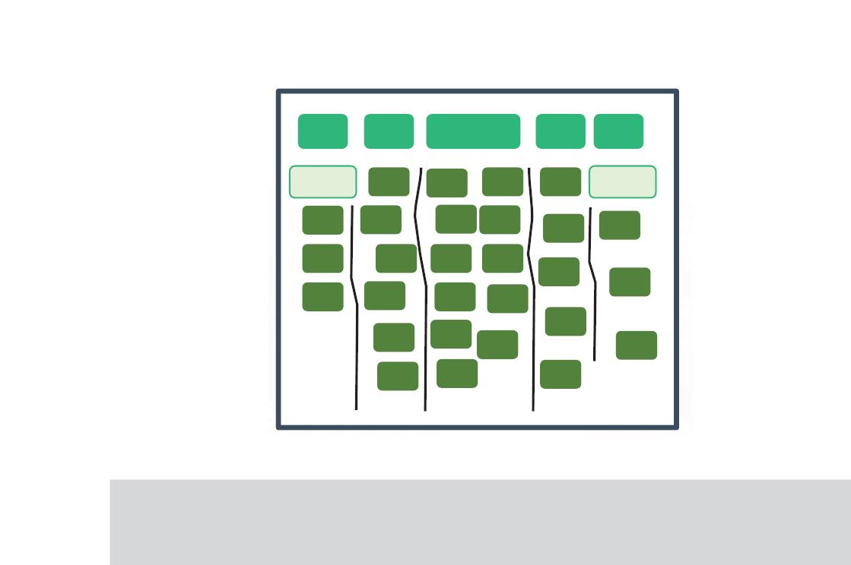
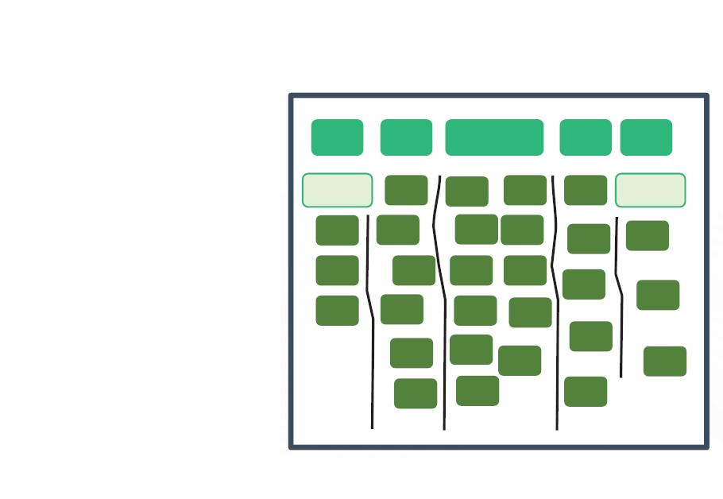
|
Module 1 Agile Practices
● After mutual discussion and agreement of the team, a relative size is ﬁrst decided, which
will be medium (M) most often.
● Numbers are then assigned to the items, according to the relative size that is assigned to
the medium size.
XS
S
M
L
XL
Smaller
Larger
Facilitator Notes:
Explain the participants about T-shirt sizes for estimating the size of agile projects.
T-Shirt sizes can be used for making high level estimates. T-shirt sizes can be used for
estimating a large backlog of relative large items. This method will be useful especially when
we have several concurrent scrum teams working on the same product. Items are estimated
into T-shirt sizes: XS, S, M, L, XL, as given in the slide above. All the estimators will assign
their own size to their items and a ﬁnal consensus is reached to get a ﬁnal estimate.
One of the disadvantages of this method is that the sizing may not be uniform. What seems
to be L for someone, may be XL for someone else.
Copyright © 2019, Xebia Group. All rights reserved. This course is licensed to UPES
| 101

Slide 98


|
Facilitator Guide Clean Code: Software Craftsmanship
What did You Grasp?
1. What is the ideal number of points can be completed in a
single iteration?
A) 0-13
B) 15-18
C) 20-25
D) 25-30
2. State True or False.
Affinity grouping is suitable only for projects with minimum
number of items.
A) True
B) False
Facilitator Notes:
Tell the participants that they will be going through a knowledge check question.
Answers:
1. a. 0-13
2. b. False
1.35 Agile Implementaꢀon in Industry Projects
Implementation of Agile across organizations can be done by several approaches. Some of
these for Developers and Management include:
Developers
Upper management







Resistance




Customer Commitments
Tracking Progress
Micromanagement
Transition from traditional to Agile processes
Distributed development
Top talent is required
Enthusiastic teams
Impact on other groups
Project completion
Testers
102 |
Copyright © 2019, Xebia Group. All rights reserved. This course is licensed to UPES

Slide 99
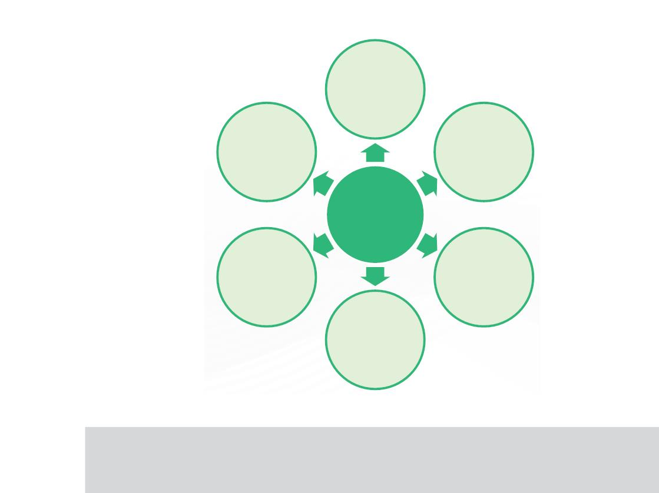
|
Module 1 Agile Practices
Facilitator Notes:
Explain the participants about the approaches in implementing Agile in industry projects.
So far, we have seen about Agile planning and estimation, which are critical steps in
implementing any Agile project. This section lists down the various approaches through which
Agile can be implemented in an organization.
1.36 Soꢁ Skills in Agile
Soft skills refer to the interpersonal skills and the ability to interact eﬀectively and harmoniously
with other people.
Agile teams and the project leaders need to have soft skills, a few of them are as follows:
Collaboration
Agile coaching
Self-leadership
Soft
Skills in
Agile
Agile servant
leadership
Adaptive
leadership
Negotiation
Facilitator Notes:
List down and explain the most important soft skills that Agile project leaders should have.
Copyright © 2019, Xebia Group. All rights reserved. This course is licensed to UPES
| 103

Slide 100
|
Facilitator Guide Clean Code: Software Craftsmanship
Agile soft skills refer to the collaboration and leadership skills the Agile team members and
leaders should possess. Some of the important ones are described below:
●
Collaboration: Collaboration refers to working together with others on a common goal that
can otherwise not be achieved alone or by a single group. This may involve planning together,
resource pooling and evaluating together. Customer collaboration is a good way to measure
project success, by taking into account their feedback throughout the life cycle of a project.
●
●
Self-leadership: Agile leaders should lead themselves ﬁrst in order to lead others. Agile leaders
should avoid leaking emotions or projecting on others. They should practice what they preach and
lead by example. They should have the clarity of what they want to do.
Adaptive leadership: The main aim of this is to adapt organizations to internal and external
pressures for change. Adaptive leadership helps imbibe a positive work culture in an organization.
Adaptive leadership is two-dimensional, i.e., being Agile and doing Agile. The four key levers for
change that every Agile leader should start with, is:
○ Do Less
○ Speed-to-Value
○ Quality
○ Engage/Inspire
The four principles that adaptive leadership applies for encouraging the engagement of followers
in helping the organization to adapt its environment are as follows:
○ Understanding the purpose of the organization
○ Utilization of people’s skills and expertise in helping with adaptation
○ Tolerating ambiguity
○ Freedom to act
●
Negotiation: Negotiation is a process by which two or more parties who are in conﬂict coming
together to ﬁnd a mutually acceptable resolution for the conﬂict. Successful negotiation needs to
have the following qualities:
○ Separate people from the problem
○ Focus on interests, not positions
○ Invent options for mutual gain
○ Use objective criteria
○ Five level of conﬂicts
104 |
Copyright © 2019, Xebia Group. All rights reserved. This course is licensed to UPES

Slide 101

|
Module 1 Agile Practices
●
Agile servant leadership: Servant leadership refers to both a leadership philosophy and set
of leadership practices. A servant leader has the qualities of deep listening, self-awareness and
commitment to others. Agile leaders should not tell the teams what to do. They should help the
team in the process of self-organization and expediting their progress. An example is that a Scrum
master should ensure that the daily standup happens and is conducted in a proper way and
estimate the team’s work.
Robert Greenleaf, the founder of the modern Servant Leadership has listed the principles of
servant leadership which include listening, empathy, awareness, persuasion, conceptualization,
foresight and stewardship.
●
Agile coaching: Agile coach helps the team grow strong in applying Agile practice to their work.
Agile coaches should have the following qualities:
○ Coach the team through change
○ Accept the team’s ideas above their own
○ Navigate conﬂict
○ Integrate paths towards high performance
What did You Grasp?
1. Which of the following could not be a soft skill of an Agile
leader?
A) Dictatorship
B) Self-leadership
C) Coaching
D) Negotiation
Facilitator Notes:
Tell the participants that they will be going through a knowledge check question.
Answer:
1. a. Dictatorship
Copyright © 2019, Xebia Group. All rights reserved. This course is licensed to UPES
| 105

Slide 102
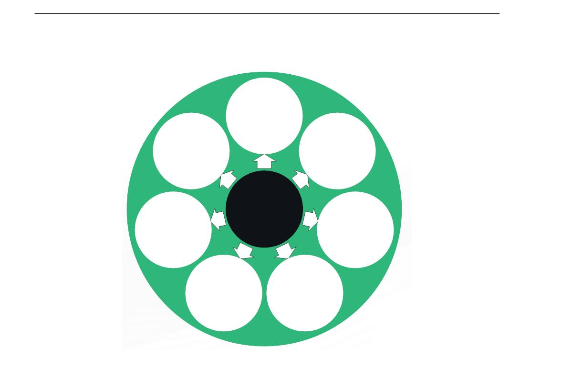
|
Facilitator Guide Clean Code: Software Craftsmanship
1.37 Lean Thinking
Lean methodology derives itself from Lean Principles in Manufacturing where more is
achieved from less. Lean thinking is governed by core principles such as:
Minimization
of waste
Holistic
view
More
learning
Lean
Build
integrity
Thinking
Late decision
making
Team
empowerment
Quick
delivery
Facilitator Notes:
Explain to participants the principles behind lean thinking and how it can be applied to
software development methodology.
Lean methodology was derived from lean principles that were applied in lean practices of
manufacturing. The crux of the idea is to see how waste can be eliminated and how software
development can be streamlined. In lean, waste is explain in a very broad sense and it refers
to any activity that be eliminated to streamline the process.
Lean methodology in software is driven by the above mentioned principles of elimination of waste,
ampliﬁed learning, an empowered team, fast delivery of features or functionality. Considering the
high demand for products should be decided as late as possible in such a way that there is no
rework. Most importantly, analyzing every single component of the process and having a holistic
view is important in lean.
106 |
Copyright © 2019, Xebia Group. All rights reserved. This course is licensed to UPES

Slide 103
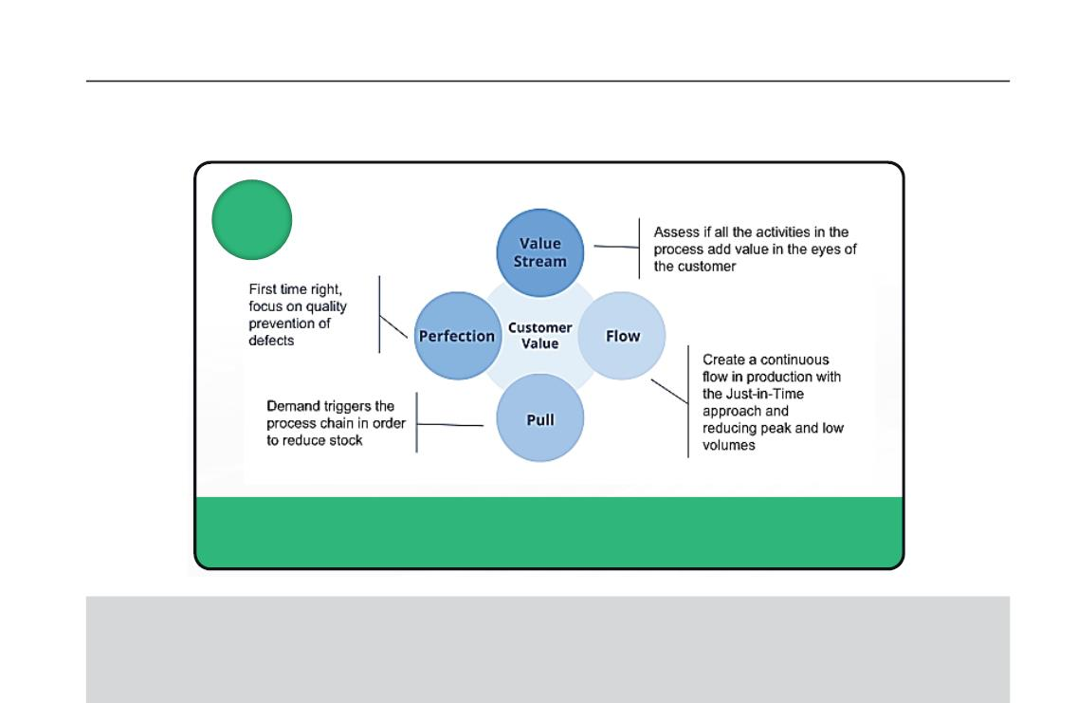

|
Module 1 Agile Practices
1.38 Lean Methodology: Customer is King
Lean places supreme importance on creating value for the customer.
Lean
Lean is delivering value to customers and continuously improving the ability to do
this, by removing waste from the entire system that produces the value.
Facilitator Notes:
Explain to participant the principle of placing the customer before everything else.
Lean Methodology in software development forms the fundamental core on which many other
methodologies such as Agile, MVP and DevOps came into existence. Lean methodology
assesses the entire value system and development lifecycle for pitfalls/loopholes that causes
waste in terms of time, man eﬀort or quality. By studying the value and its components
continuously, we focus of continuous improvement of the process and quick delivery of product.
What did You Grasp?
1. Which of the following options is not a LEAN principle?
A) Elimination of fees
B) Slow delivery of features
C) Late decision making
D) Holistic approach
Copyright © 2019, Xebia Group. All rights reserved. This course is licensed to UPES
| 107

Slide 104

|
Facilitator Guide Clean Code: Software Craftsmanship
Facilitator Notes:
Correct Answer
1. B. Slow delivery of features
1. Agile methodology
2. Software, History of Software Engineering and
Software Development Methodologies
3. Traditional Software Development Models
4. Waterfall Model, Classical Waterfall Model
5. Traditional IT Organizations
6. Developers vs IT Operations Conflict
7. Birth of Agile, Four Values of the Agile
Manifesto
8. Scrum, Scrum Theory, Scrum Values, Scrum
Roles, Scrum Master
Scrum Sprints, Benefits of Scrum
9. Planning and Estimation, Agile Planning, Levels
of Agile Planning
10.Conditions of Satisfaction, Velocity
11.Estimating Techniques
12.Soft Skills in Agile
13.Kanban Model
108 |
Copyright © 2019, Xebia Group. All rights reserved. This course is licensed to UPES

